Slide 1
e-Procurement
Corrigendum for Extension of Technical Bid Opening including Bid Submission Closing Date/Time
&
Also how to Check Total Bid received using MIS Report

Slide 2
Click on eProcure

Slide 3
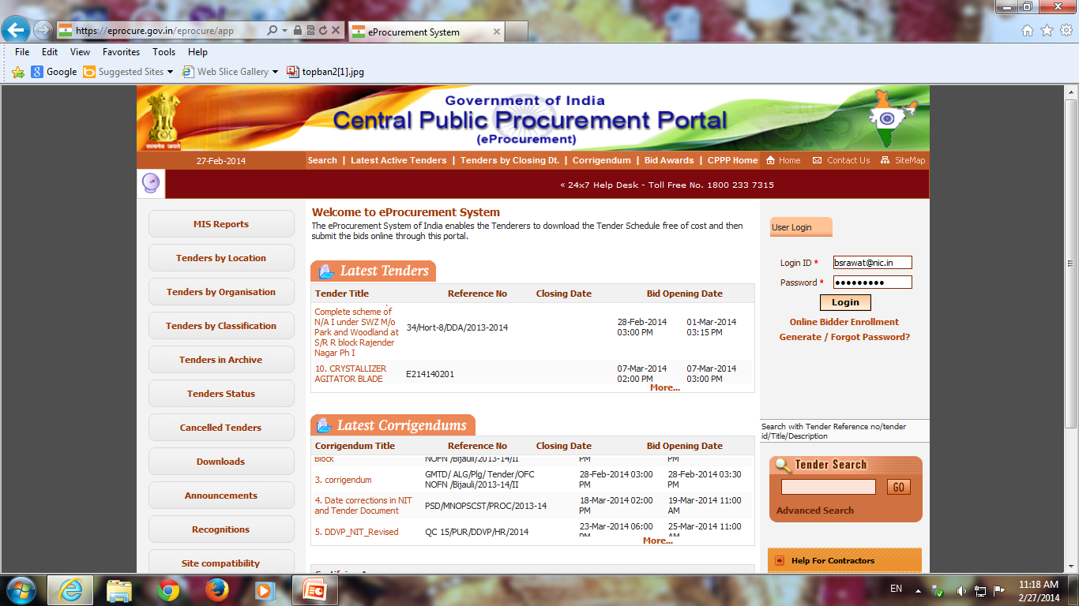
Fill the User Id, Password and Click Login

Slide 4
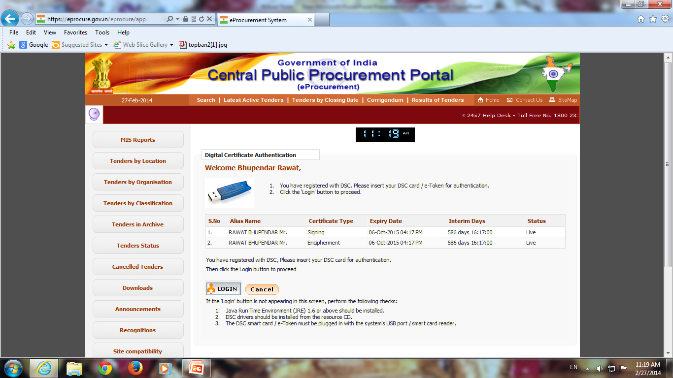
Click on Login

Slide 5
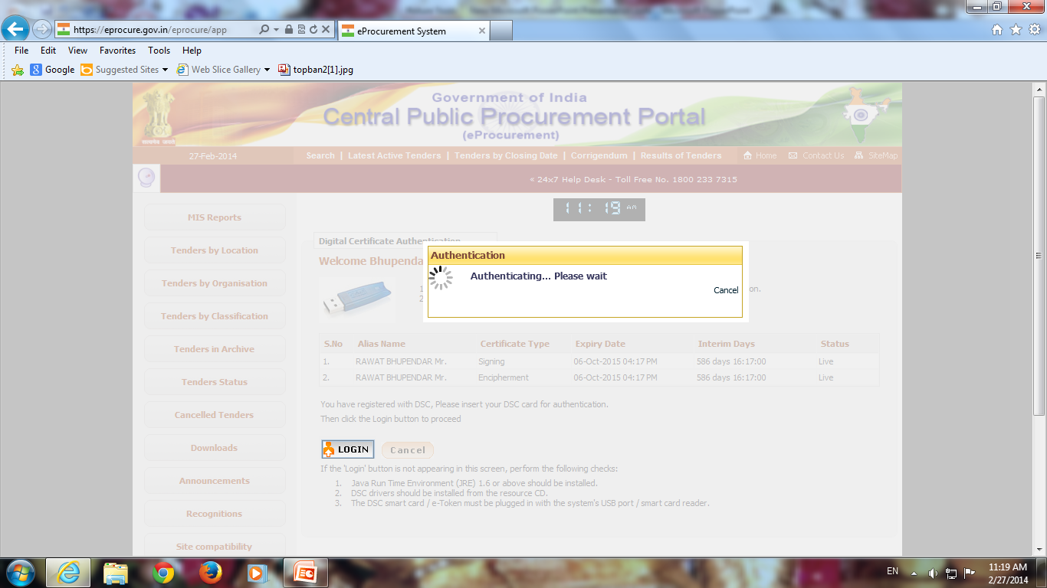

Slide 6
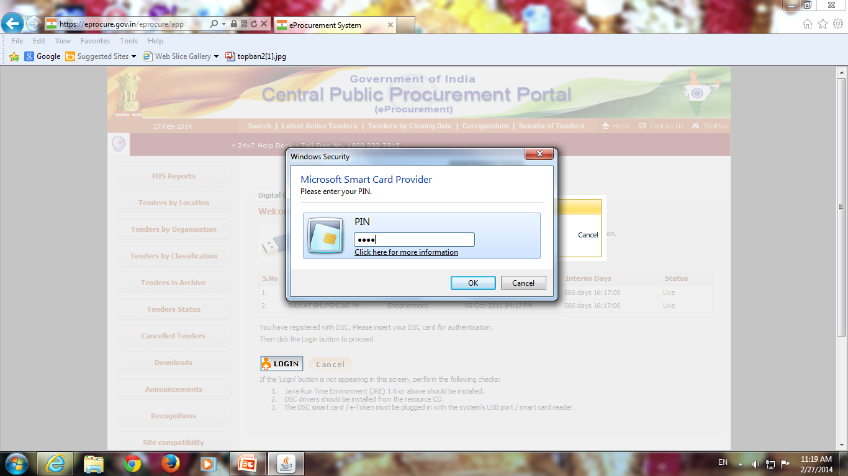
Enter DSC Password and Click Ok

Slide 7
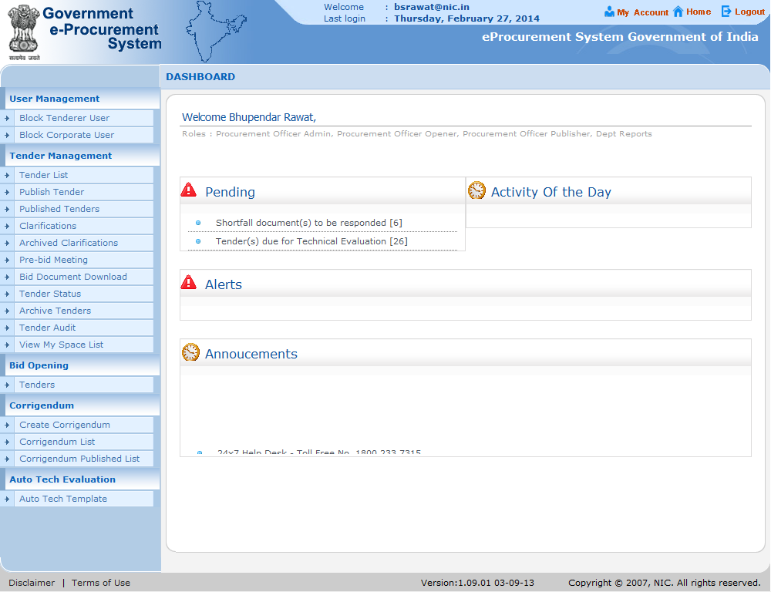
Click on Create Corrigendum

Slide 8
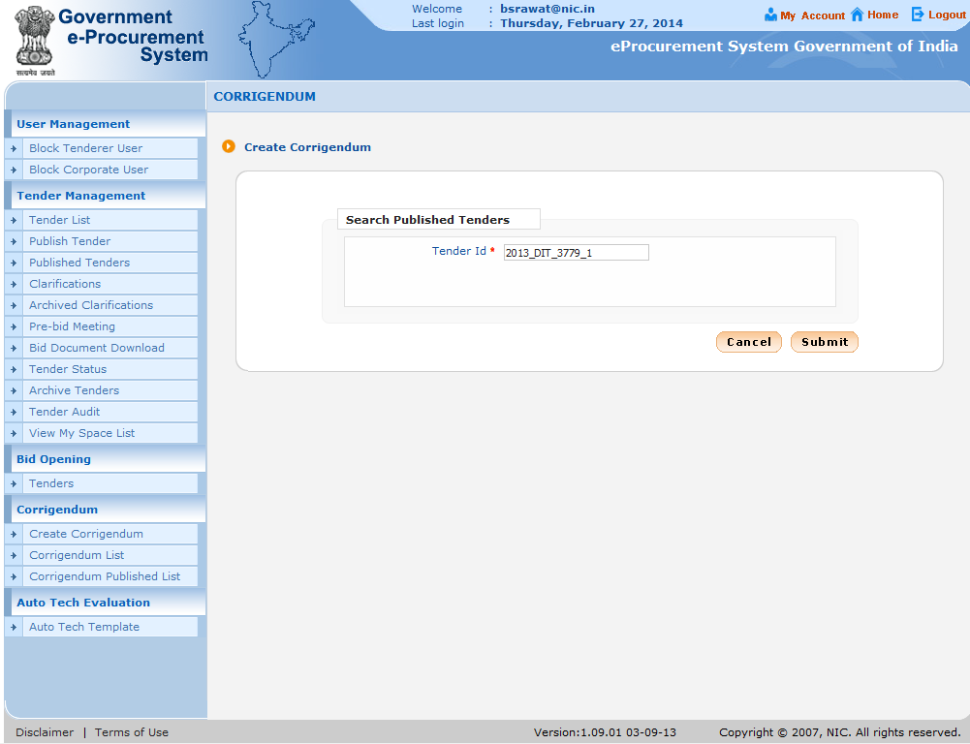
Fill Tender ID and Click Submit

Slide 9
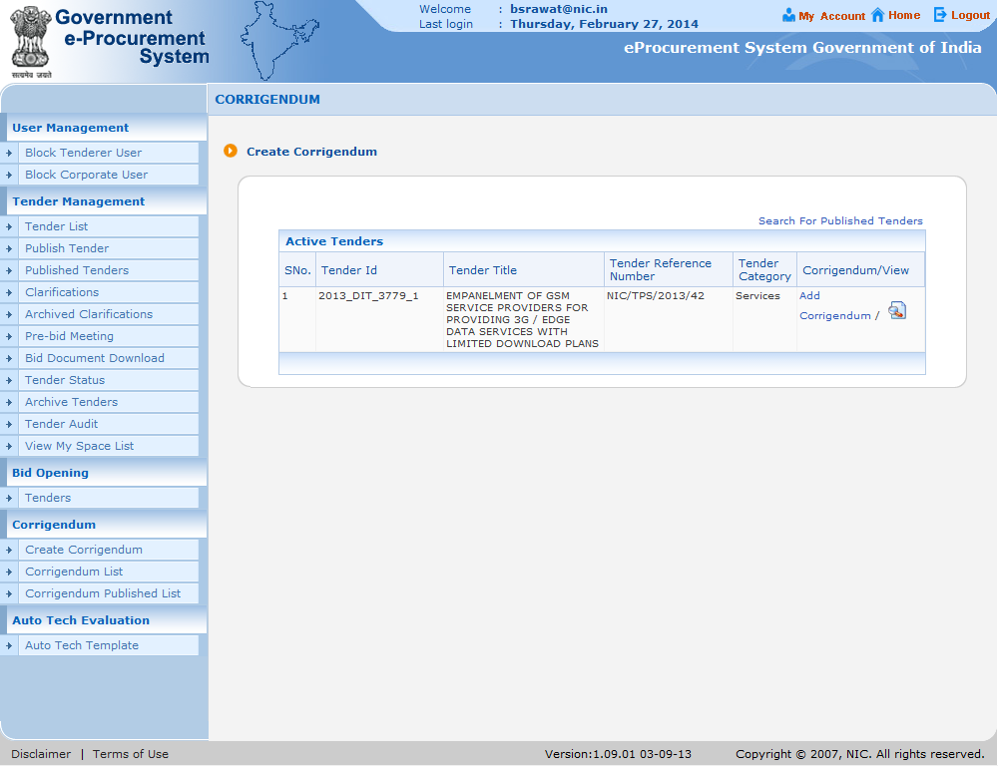
Click on Add Corrigendum

Slide 10
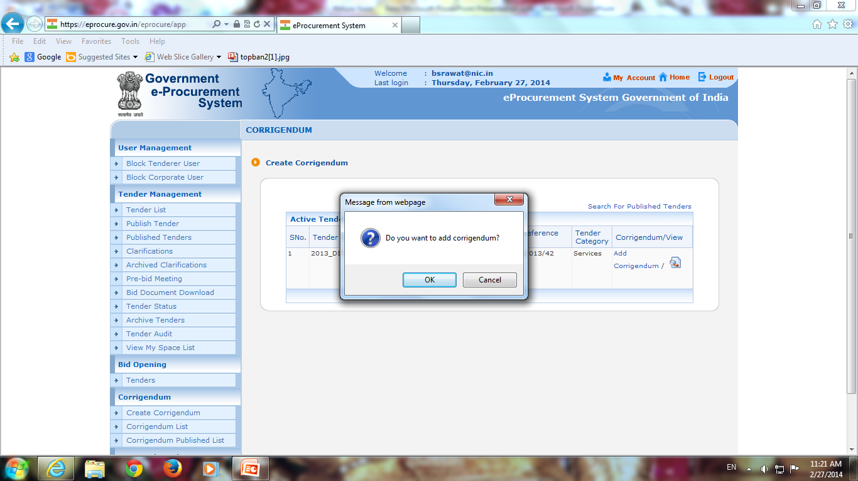
Click Ok

Slide 11
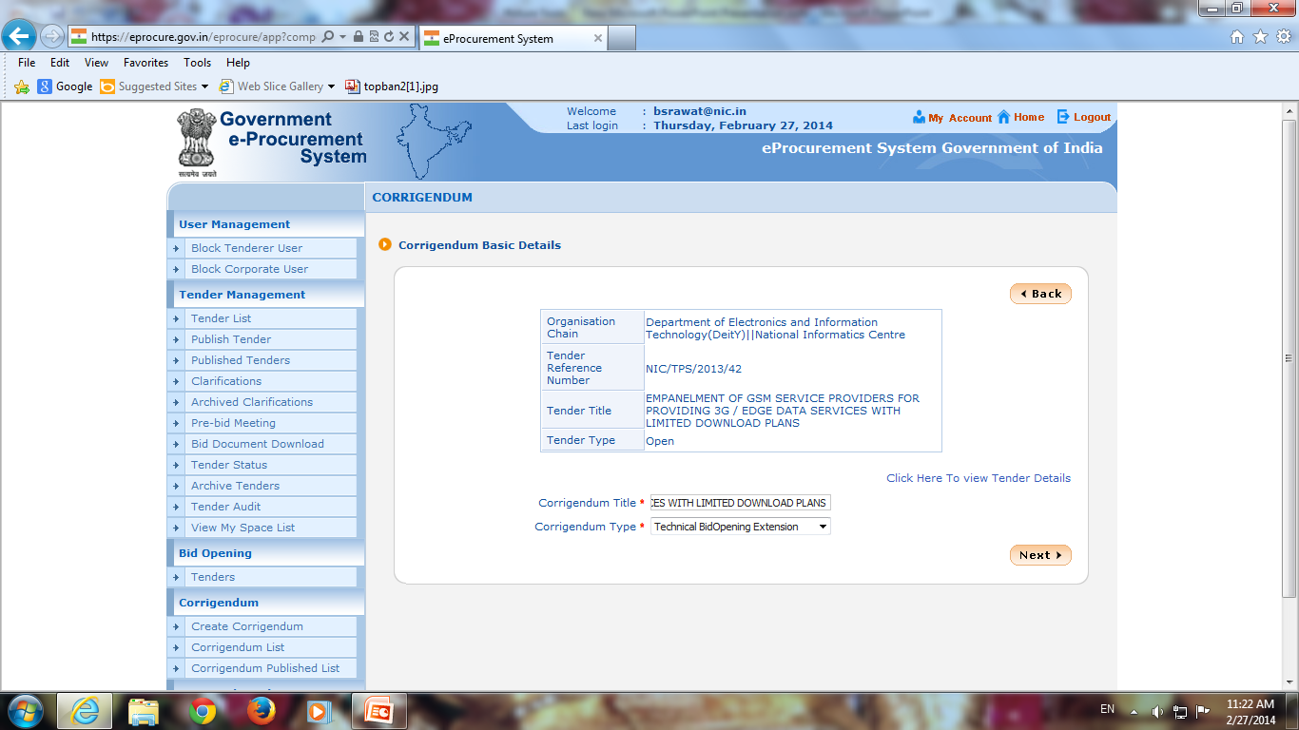
Fill Corrigendum Title
Select Corrigendum as Technical Bid Opening Extension
Click on Next

Slide 12
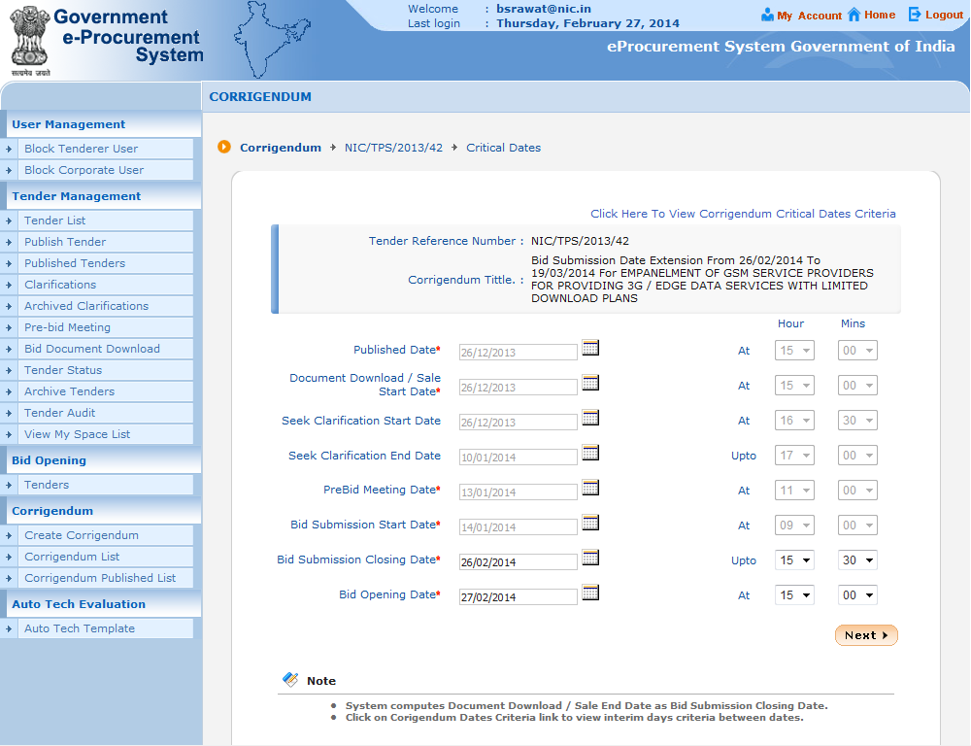
Note:- Today is 27/02/2014 11:20 AM. Bid submission last date was 26/02/2014 which is over. Bid opening time is yet to reach. So we can change Bid Opening Date/Time as well as Bid Submission Closing Date/Time
Click on Icon to change Bid Submission Date
Click on Icon to change Bid Opening Date

Slide 13
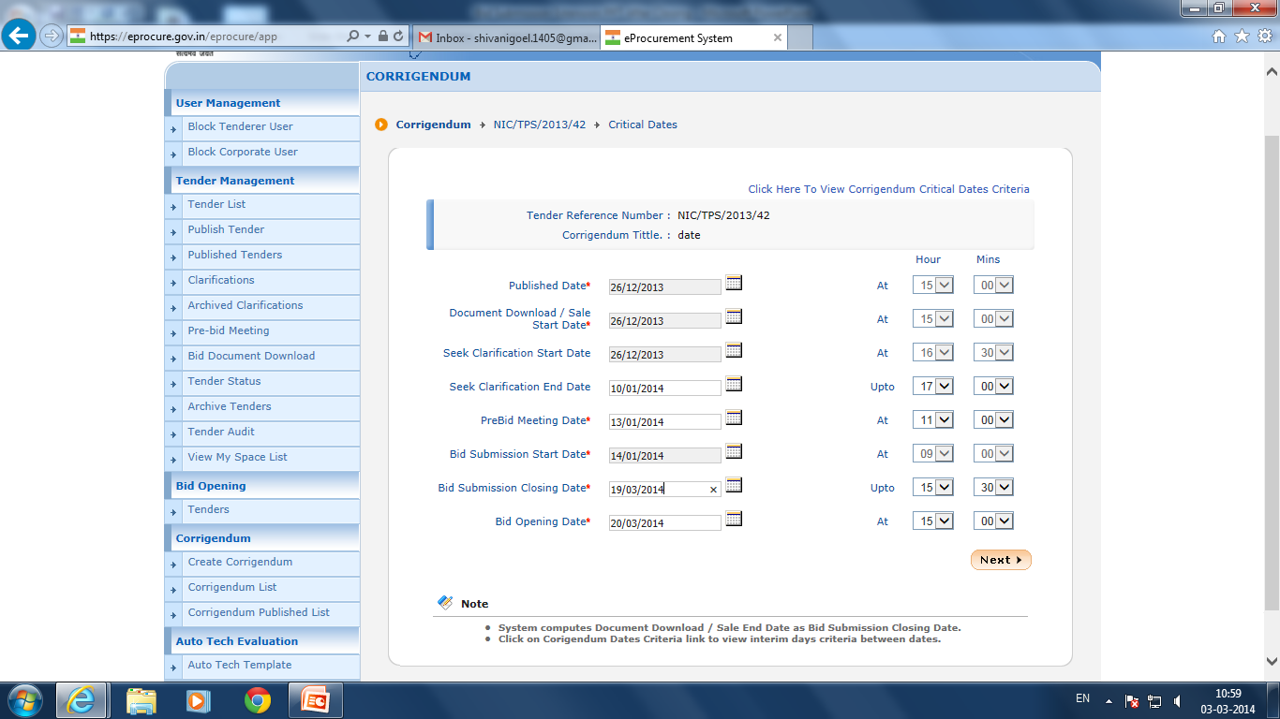
Click on Next

Slide 14
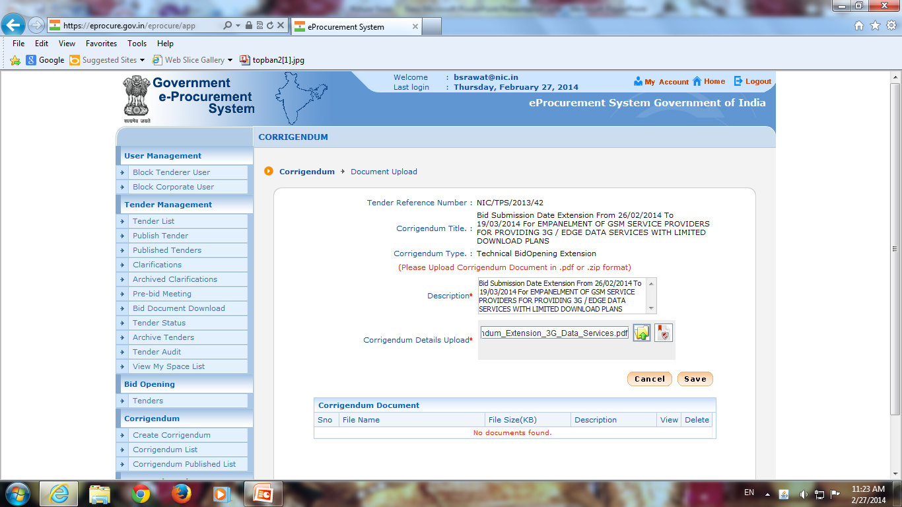
Fill Description
Click on Icon to select document

Slide 15
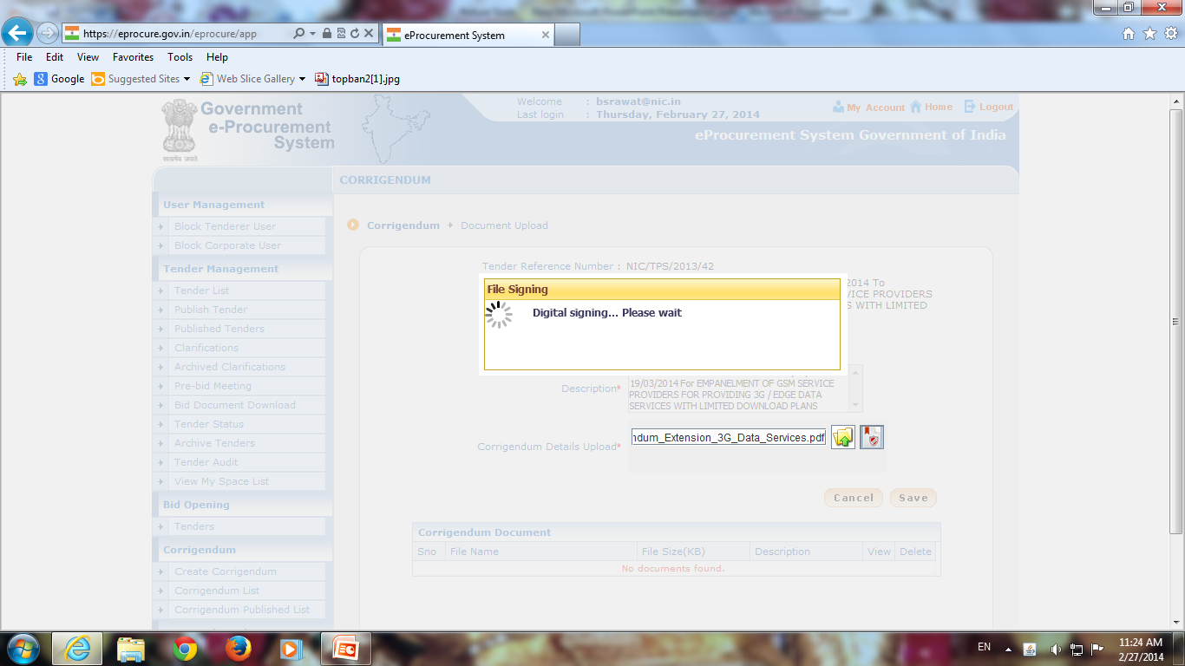

Slide 16
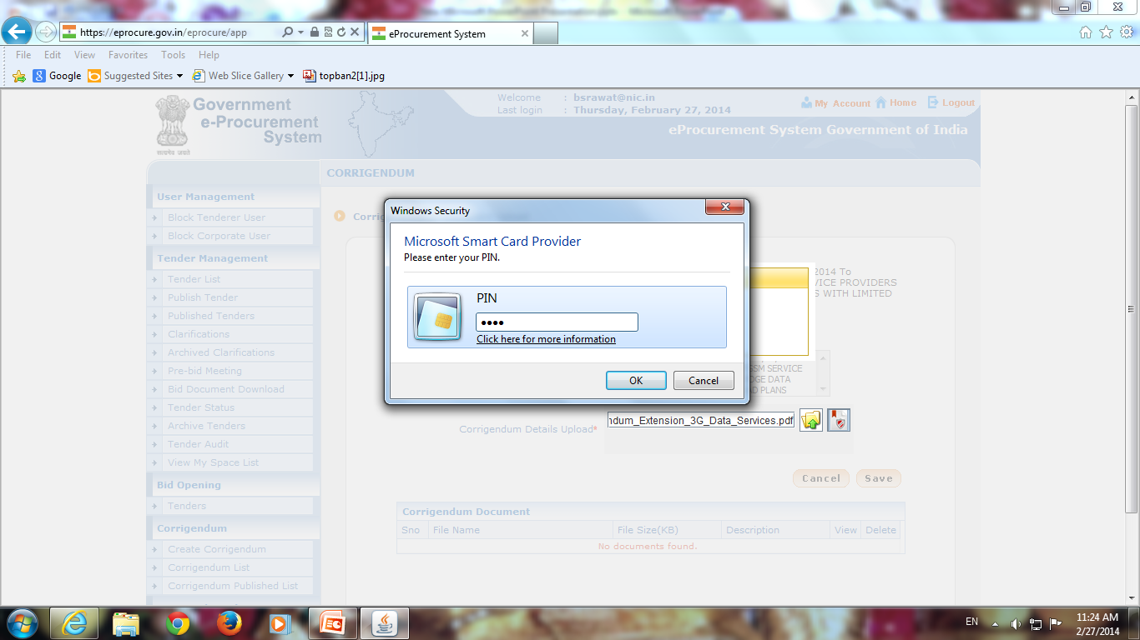
Enter DSC Pin
Click Ok

Slide 17
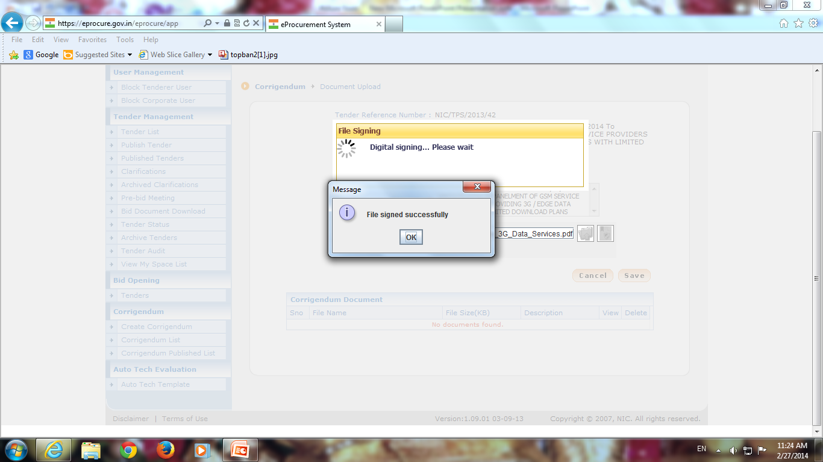
Click Ok

Slide 18
Click on Save

Slide 19
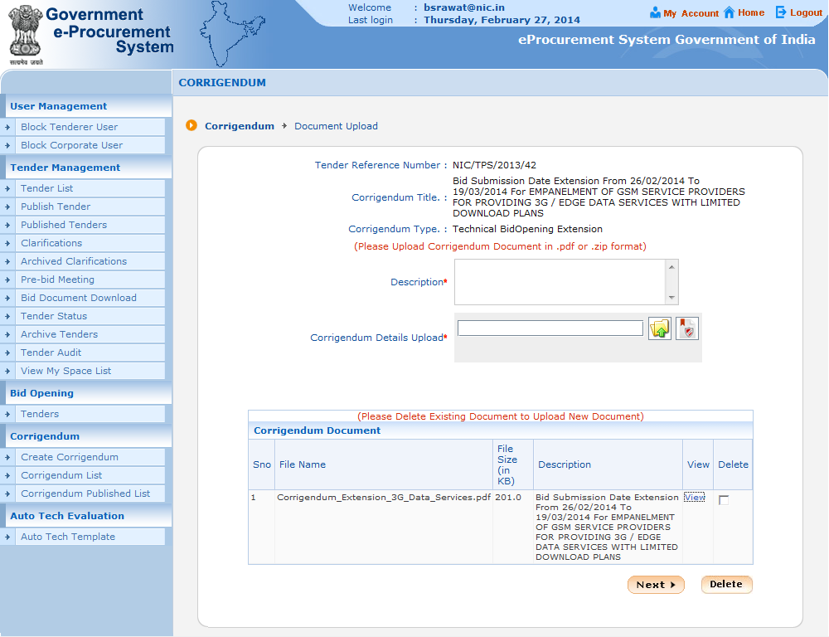
Document added here
Click on Next

Slide 20
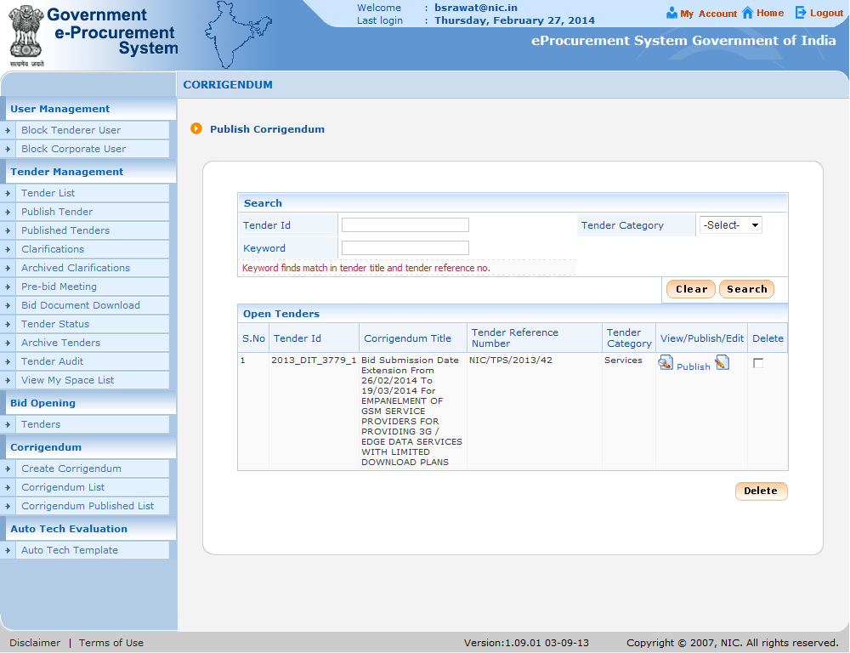
Click on Publish

Slide 21
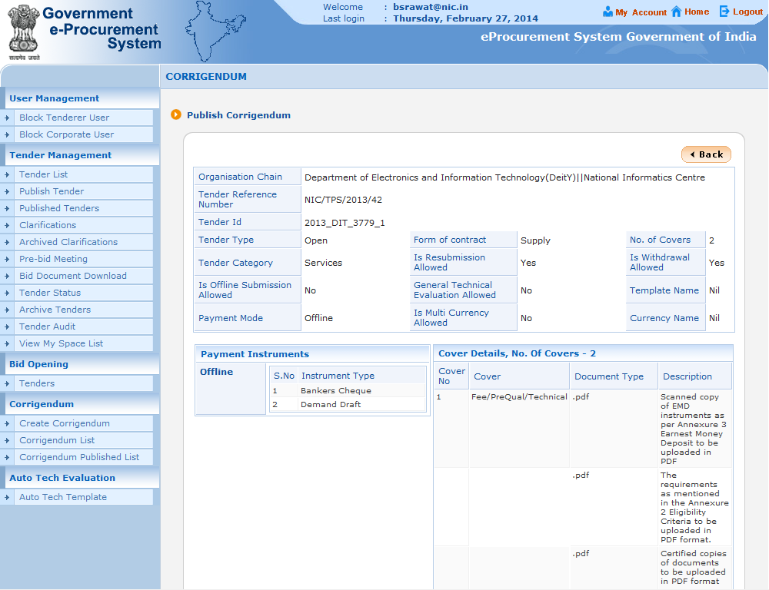

Slide 22
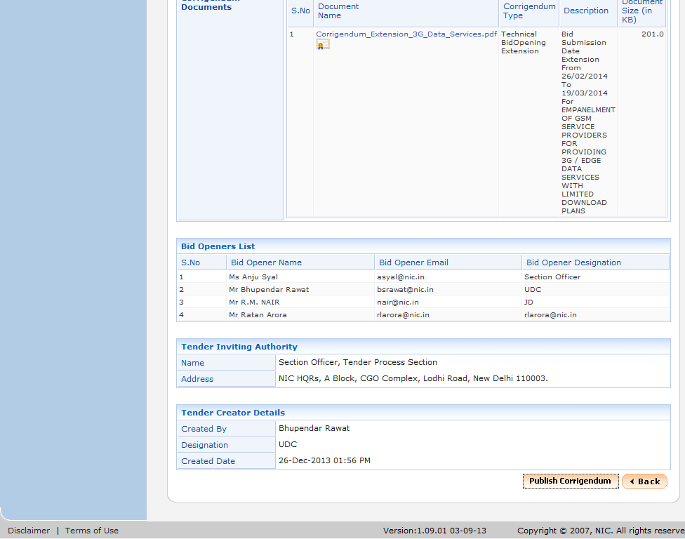
Click on Publish Corrigendum

Slide 23
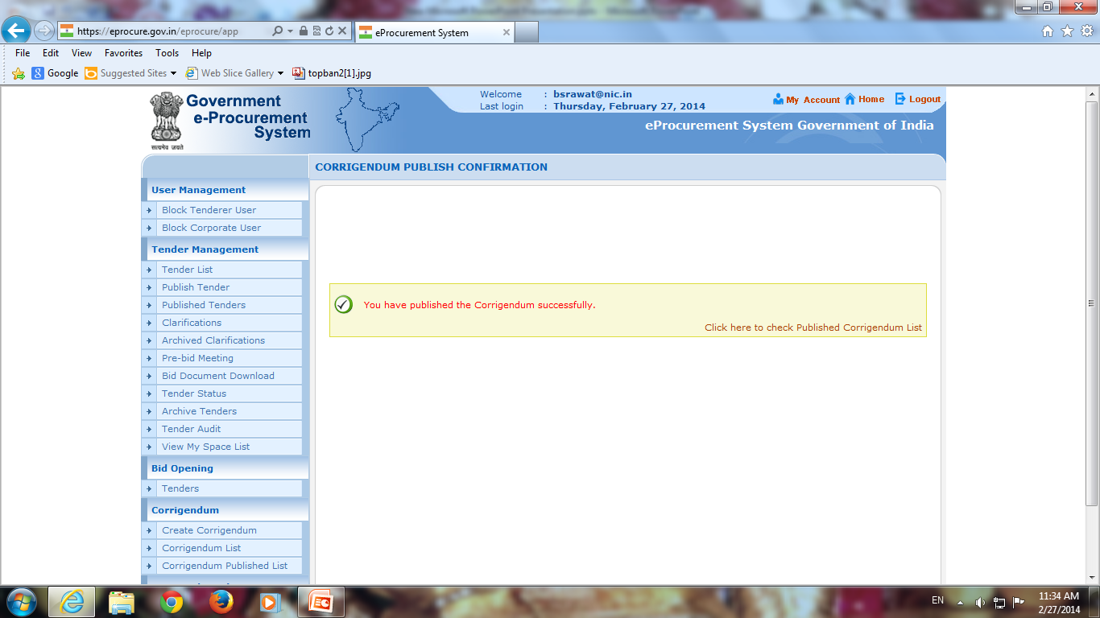

Slide 24
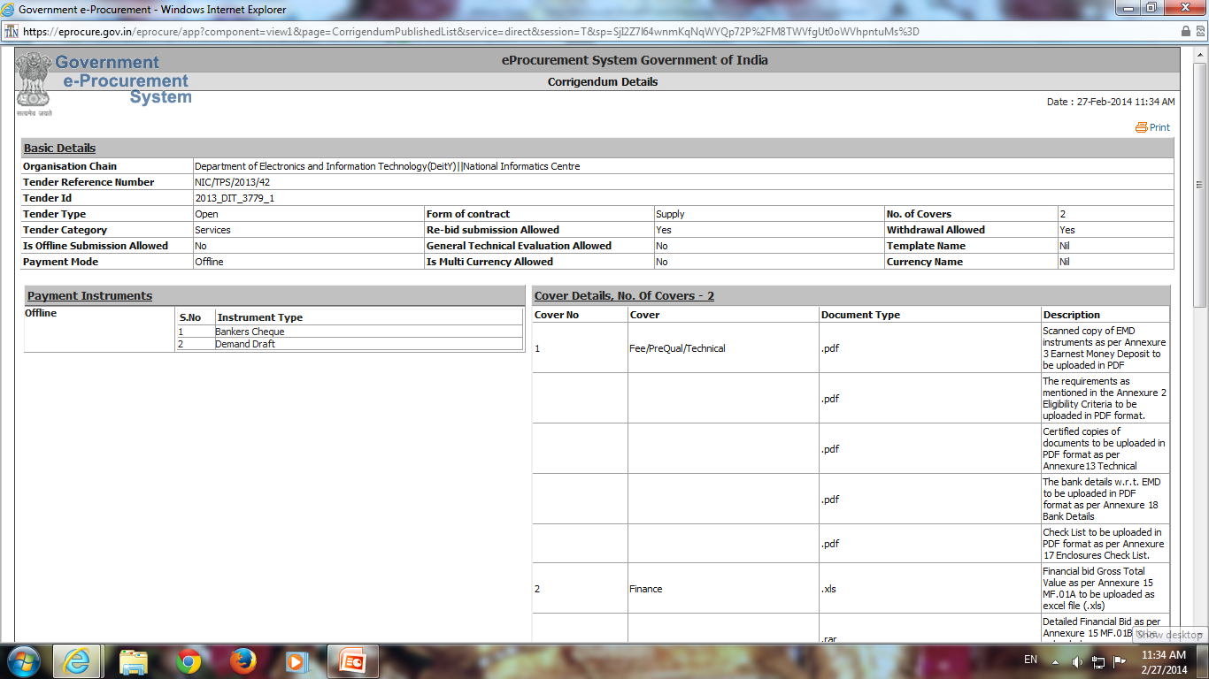

Slide 25
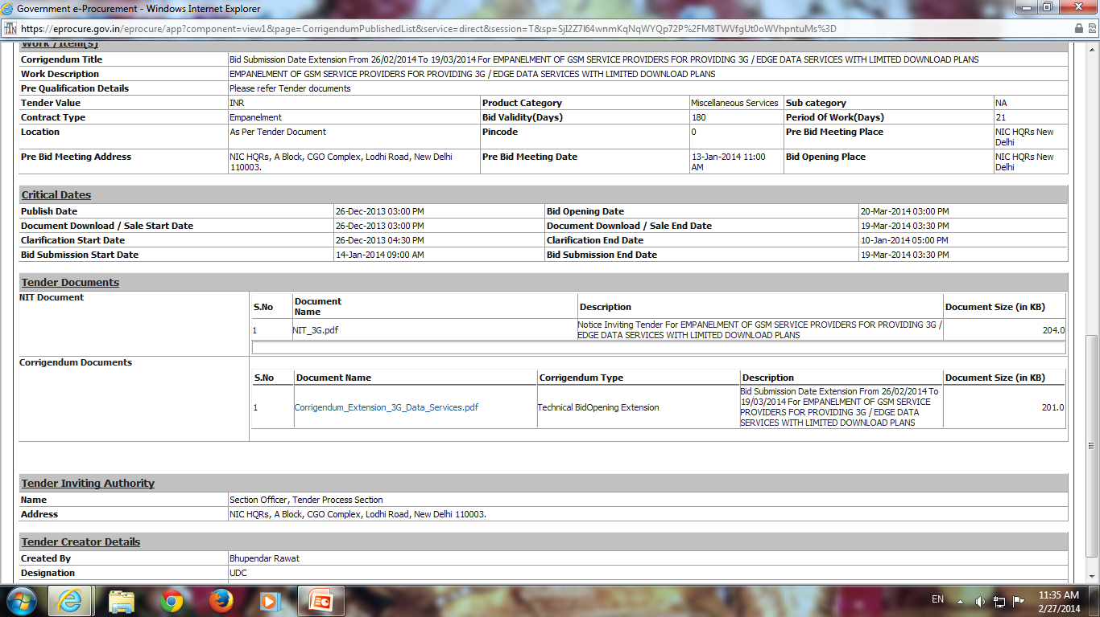

Slide 26
e-Procurement
Check Total Bid received using MIS Report

Slide 27
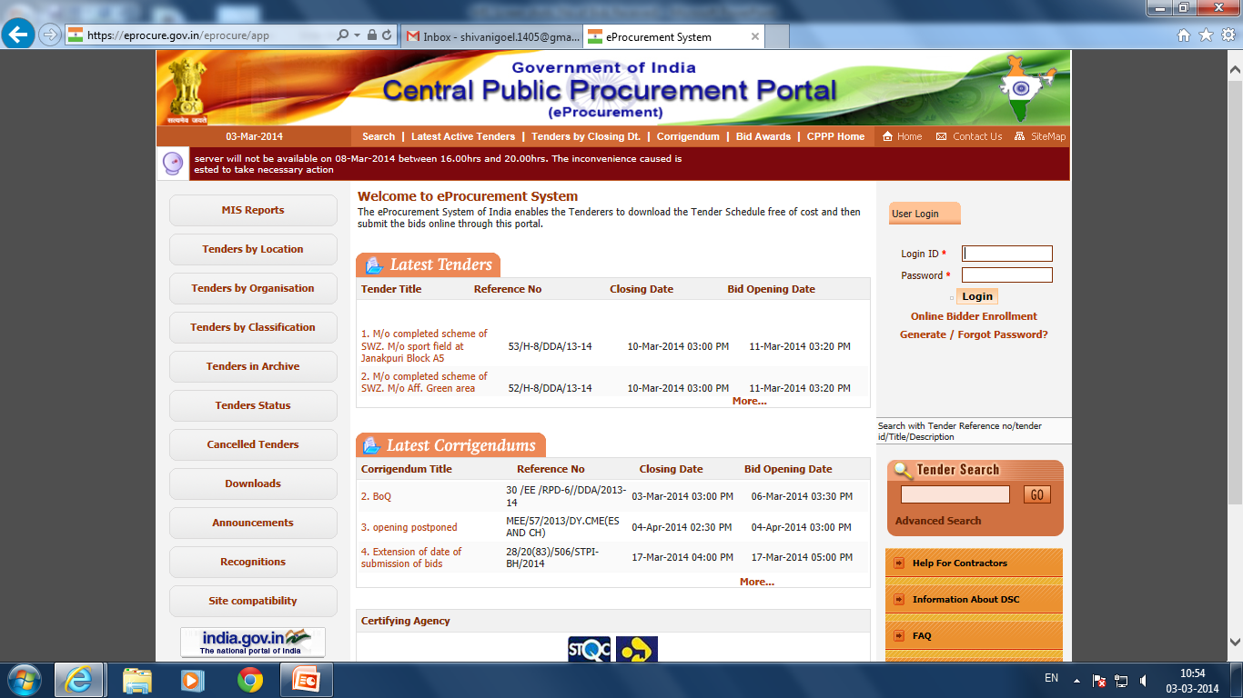
Click on MIS Report

Slide 28
Fill User ID, Password and click Login

Slide 29
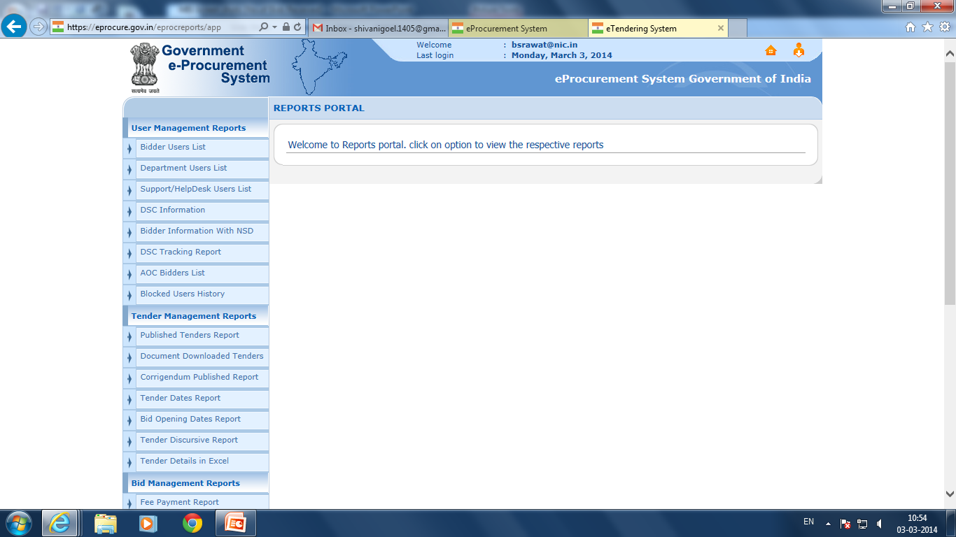
Click on Tender Detail in Excel

Slide 30
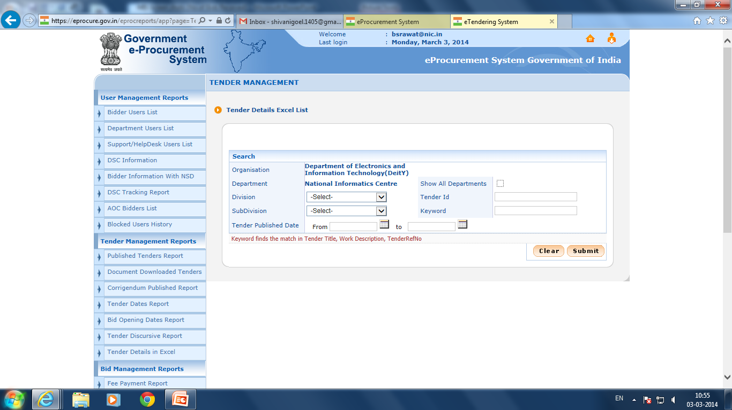
Click on Submit

Slide 31
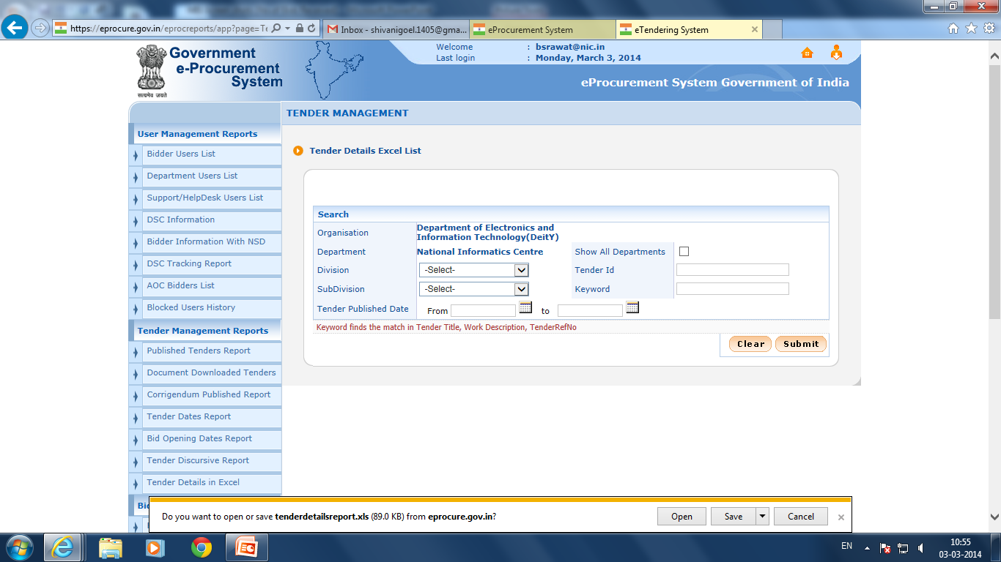
Click on Save

Slide 32
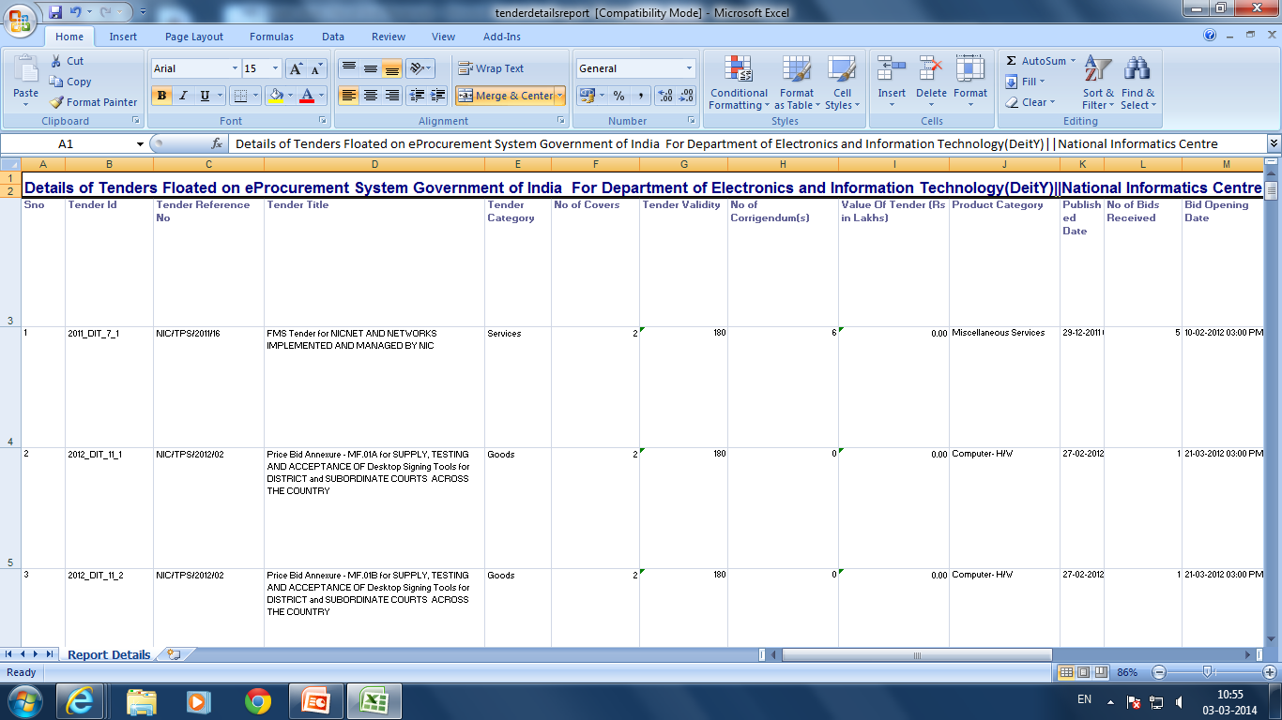

Slide 33
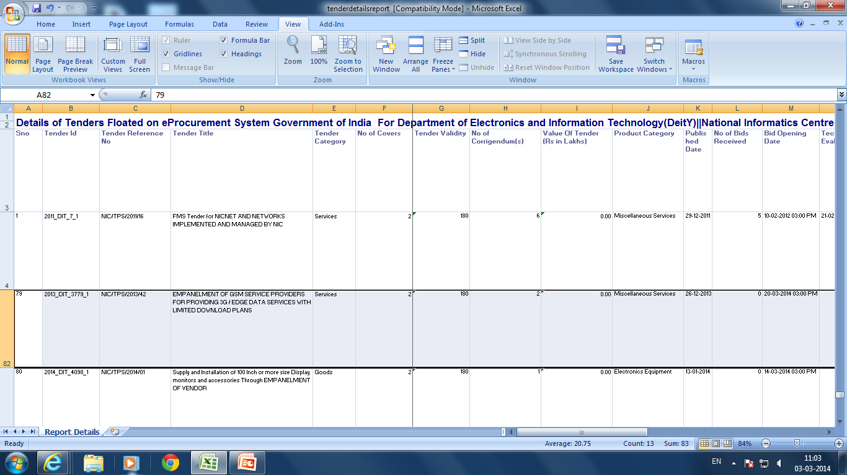
Total No. Of Bids Received

