Slide 1
e-Procurement
CORRIGENDUM

Slide 2
Click on eProcure

Slide 3
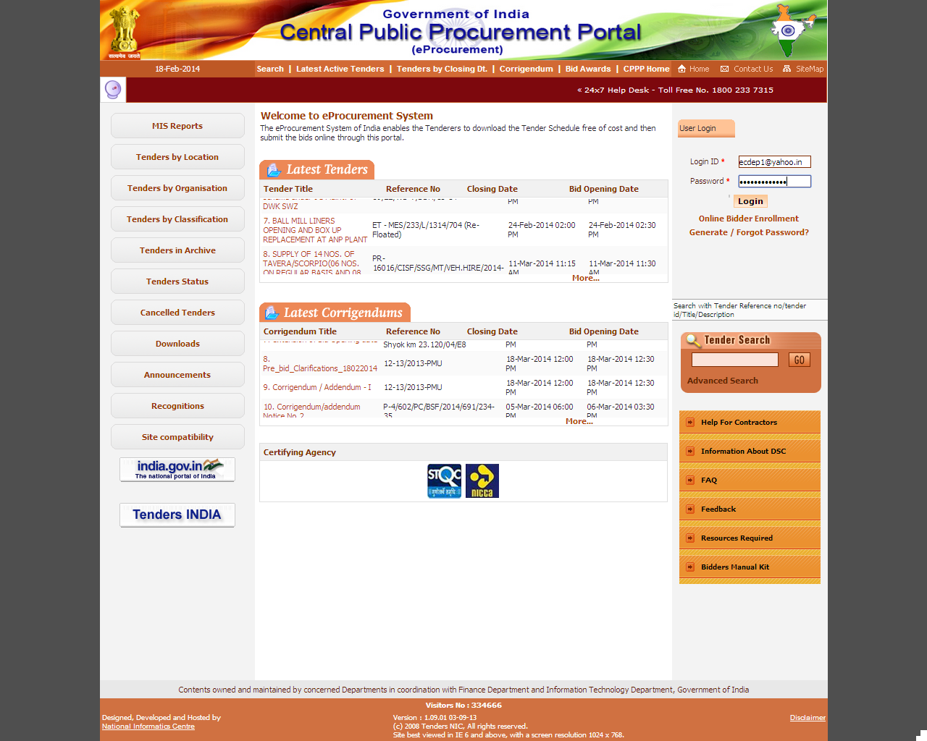
Fill user Id , password and click Login

Slide 4
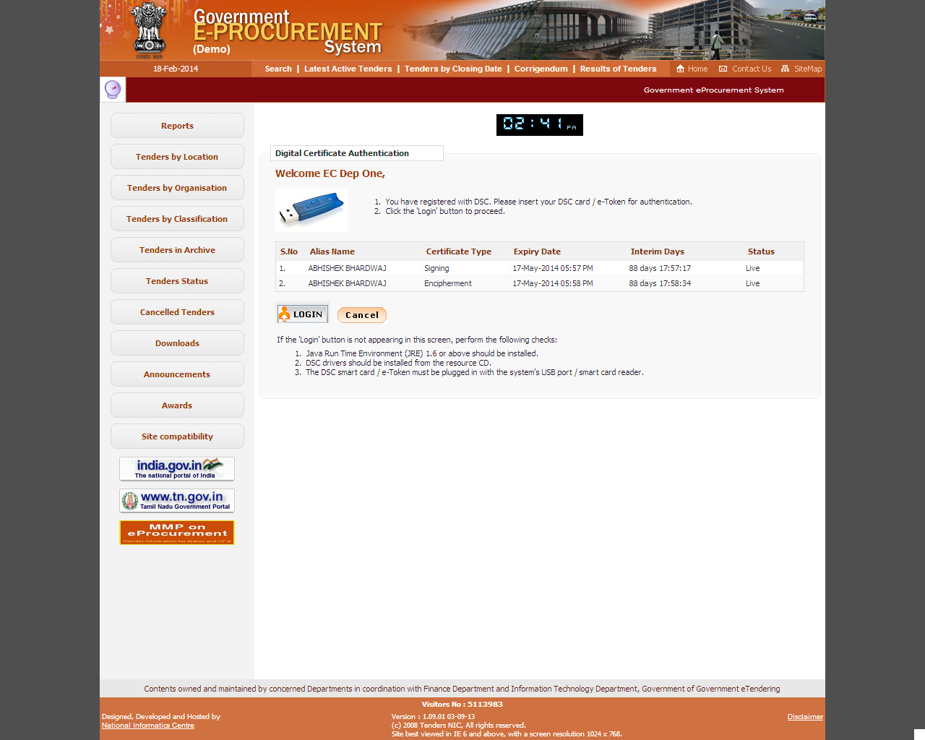
Click on Login

Slide 5
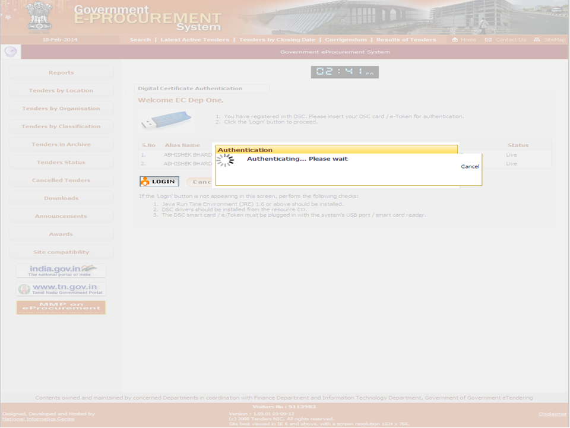

Slide 6
e-Procurement
Corrigendum for Date

Slide 7
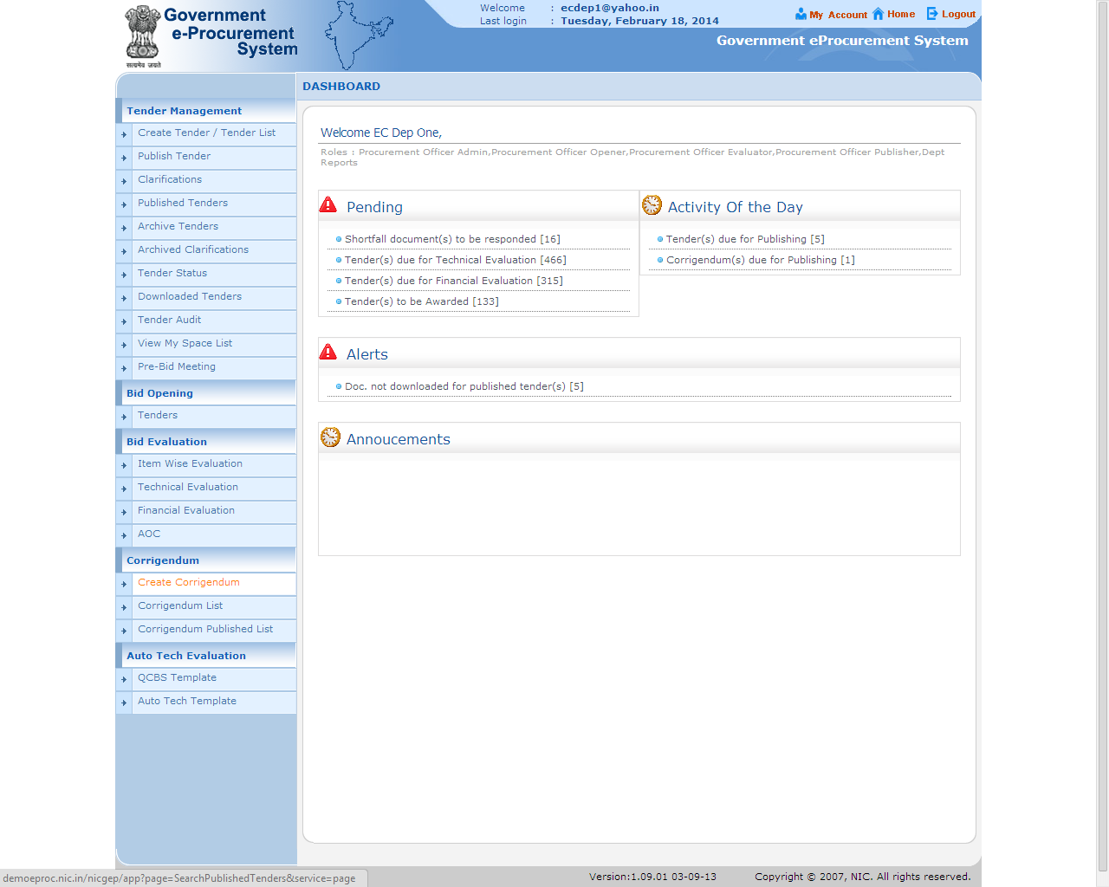
Click on Create Corrigendum

Slide 8
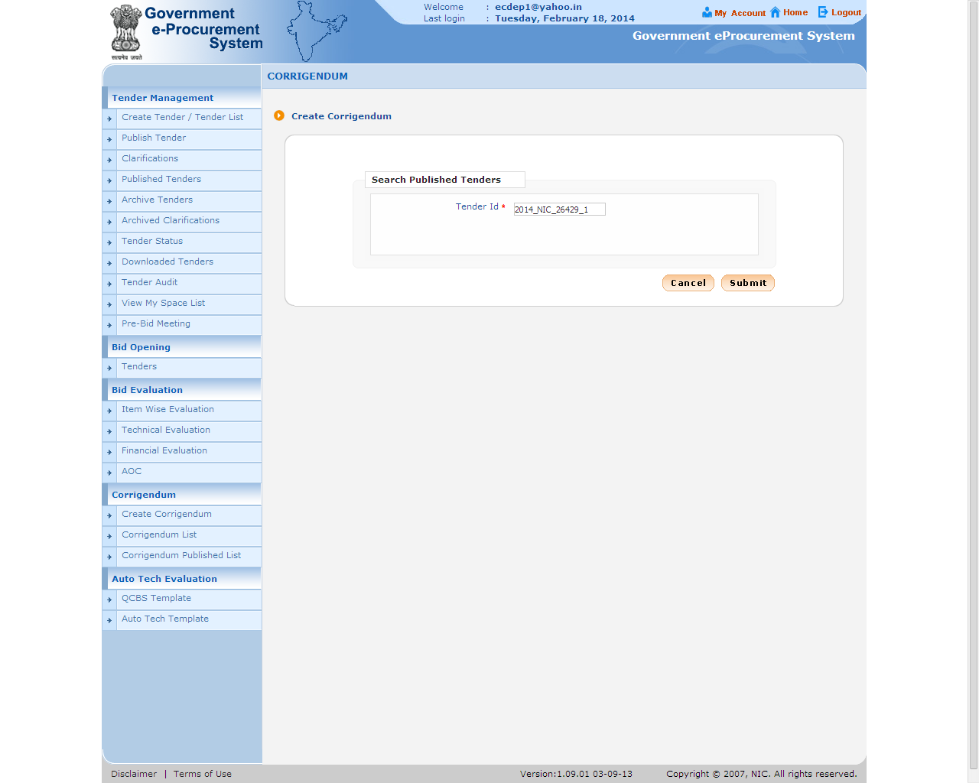
Fill Tender Id
Click on Submit

Slide 9
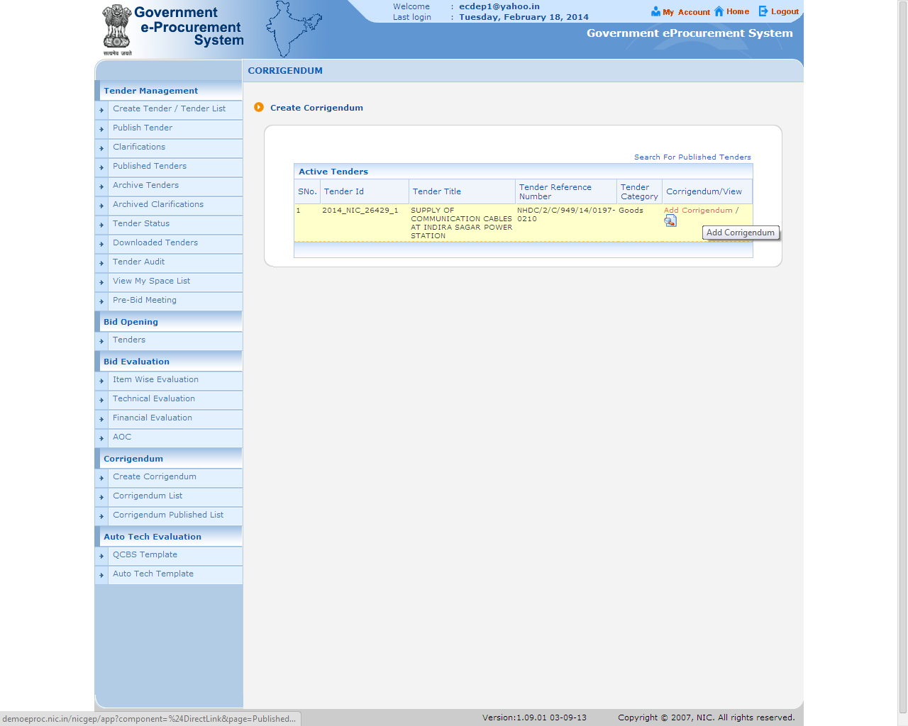
Click on Add Corrigendum

Slide 10
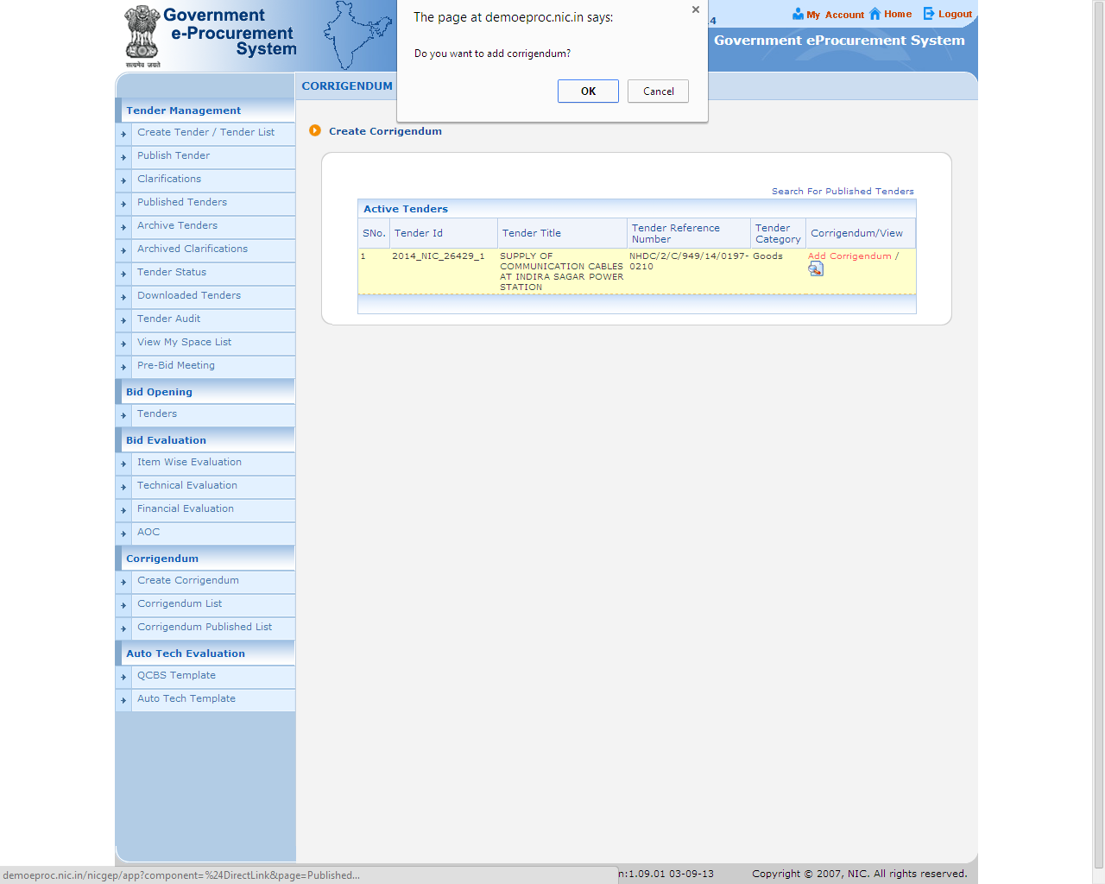
Click OK

Slide 11
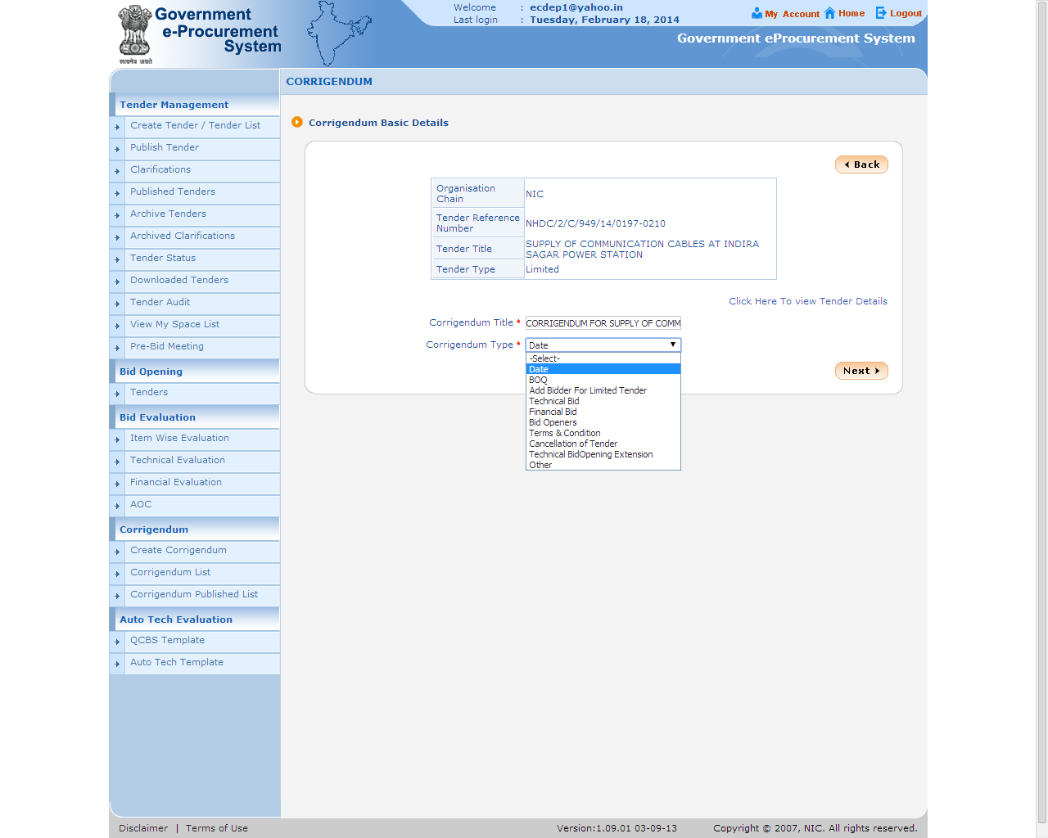
Click Next
Fill Corrigendum Title and select its type

Slide 12
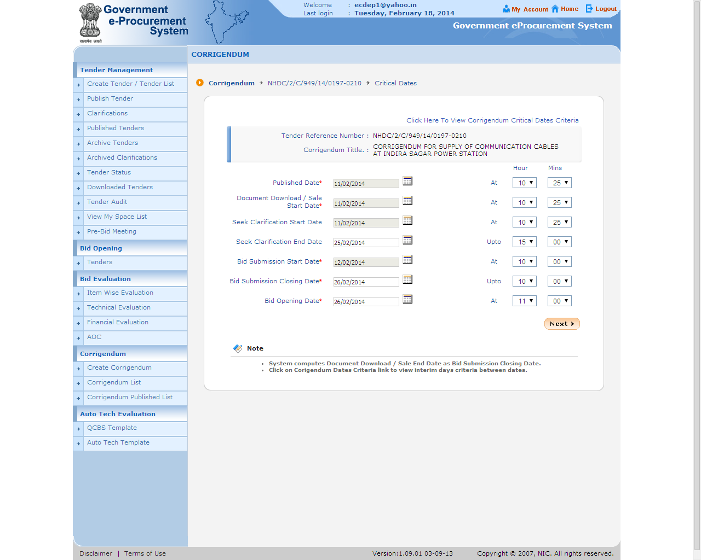
Fill relevant date , time and click Next
Note: - Bid opening date and time cannot be changed here. It can be done only through ‘Corrigendum-Technical Bid Opening Extension’

Slide 13
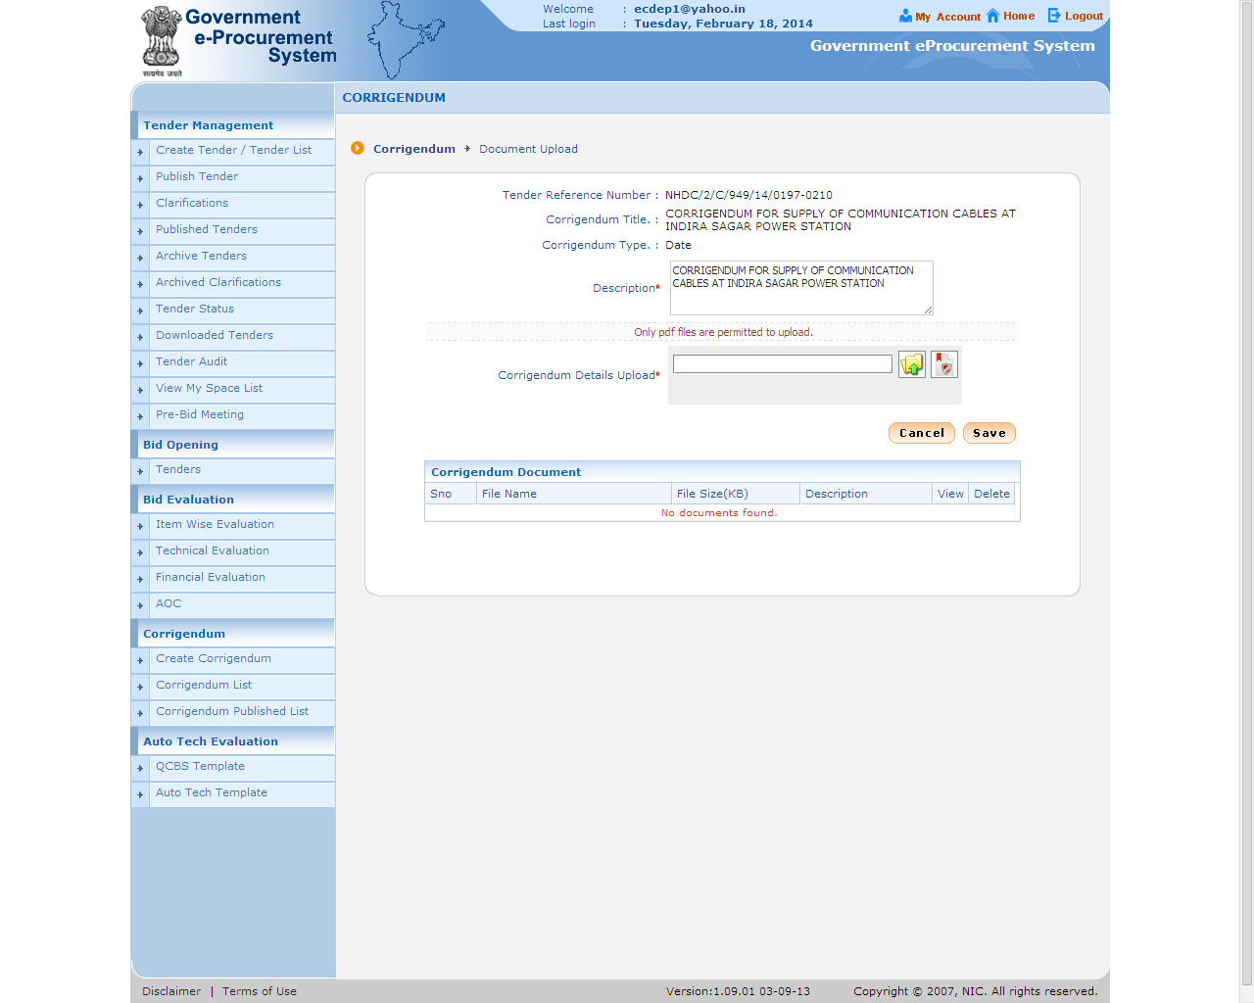
Click on icon to upload Corrigendum details
Fill Description

Slide 14
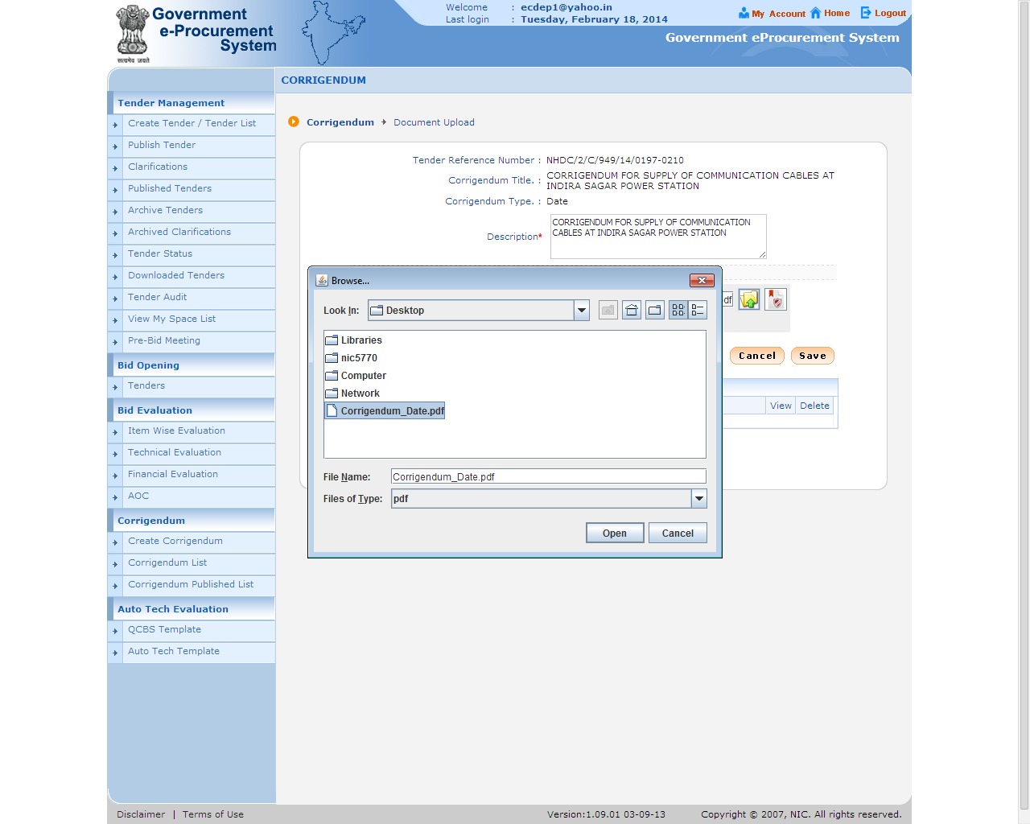
Select document and click Open

Slide 15
Click on icon to digitally sign the document

Slide 16
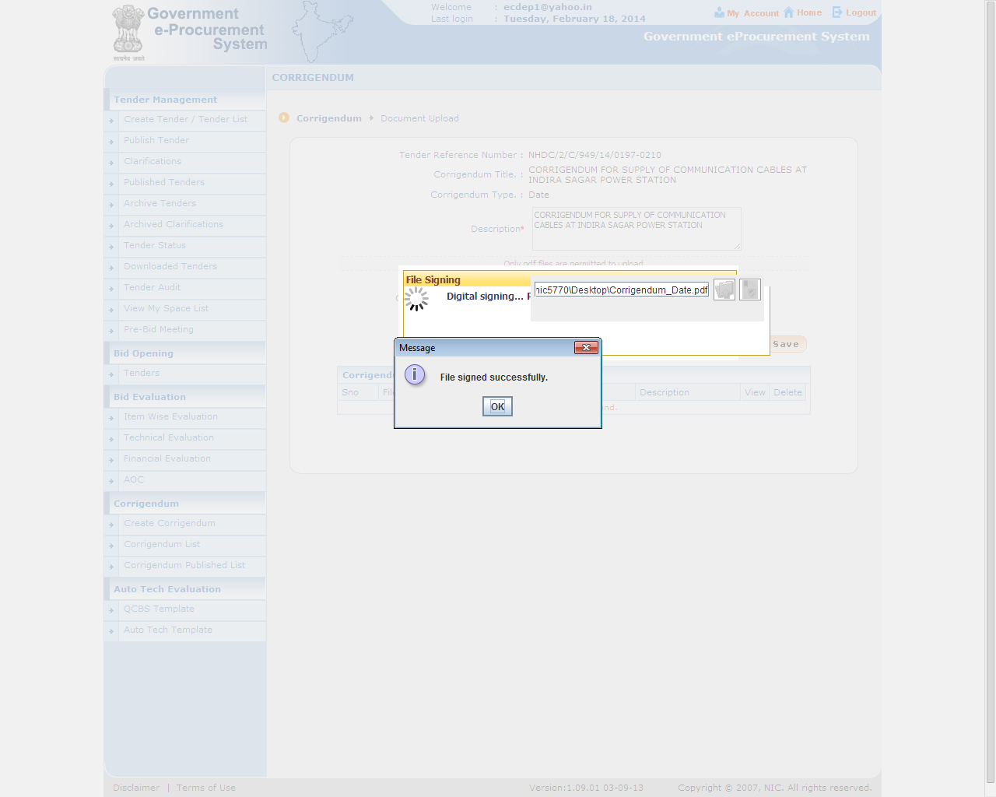
Click OK

Slide 17
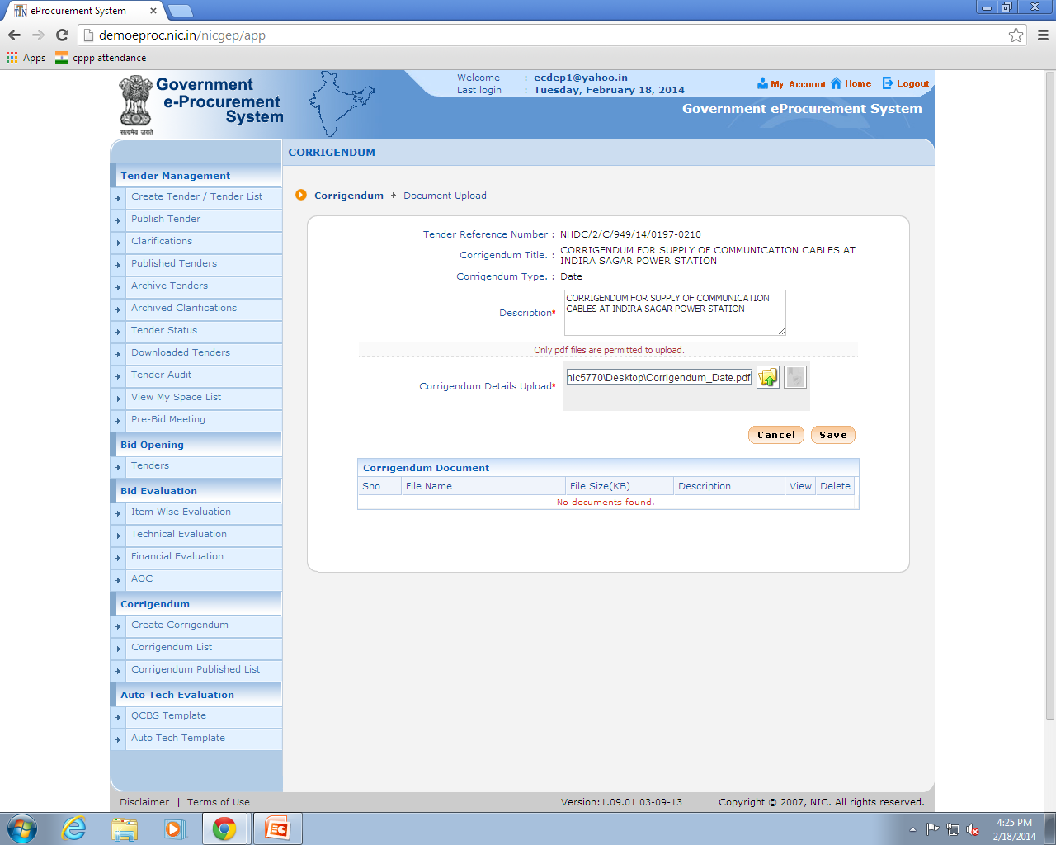
Click Save

Slide 18
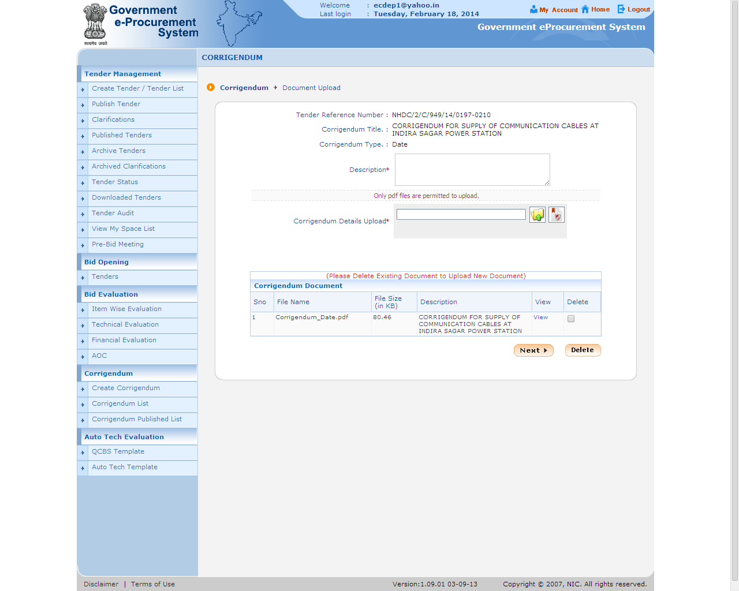
Document added here
Click Next

Slide 19
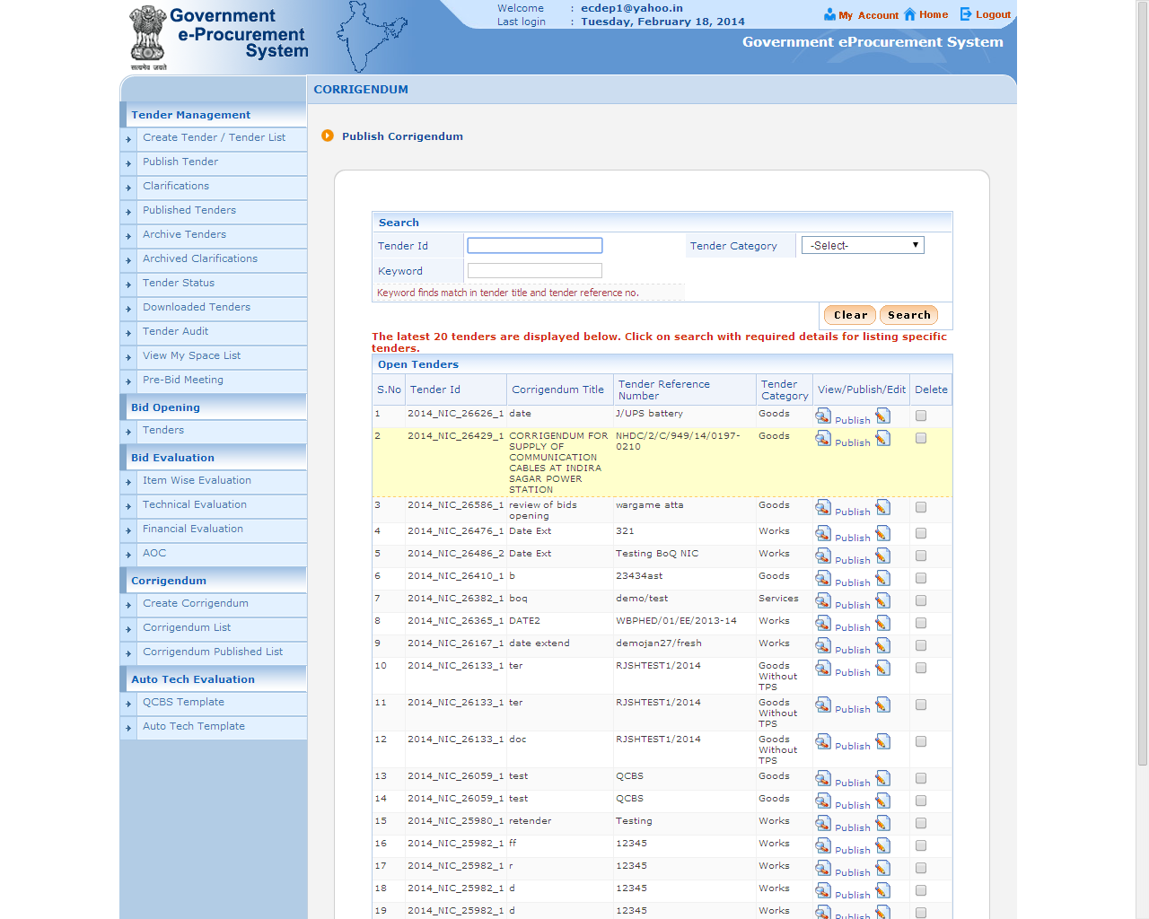
Click on Publish

Slide 20
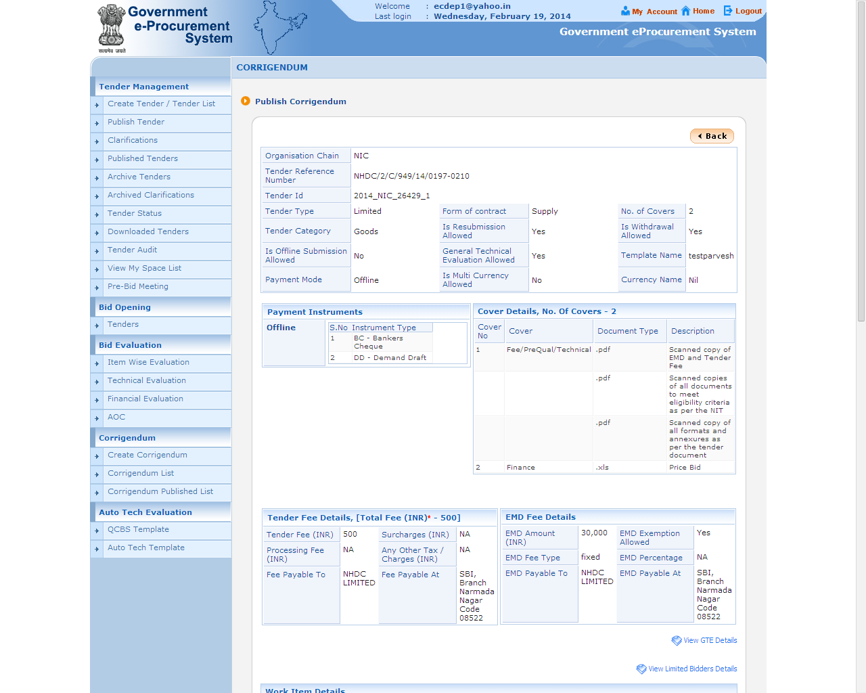
Corrigendum detail

Slide 21
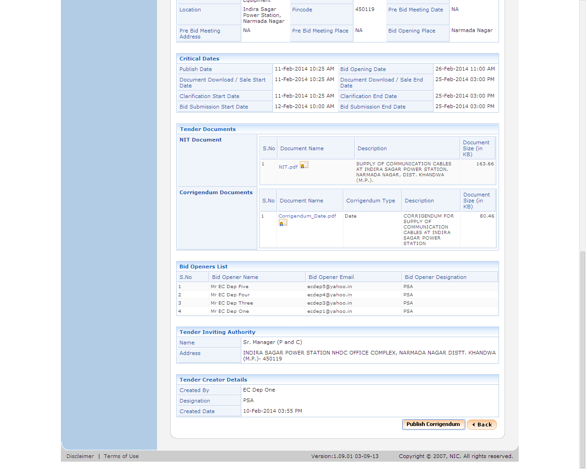
Click on Publish Corrigendum

Slide 22
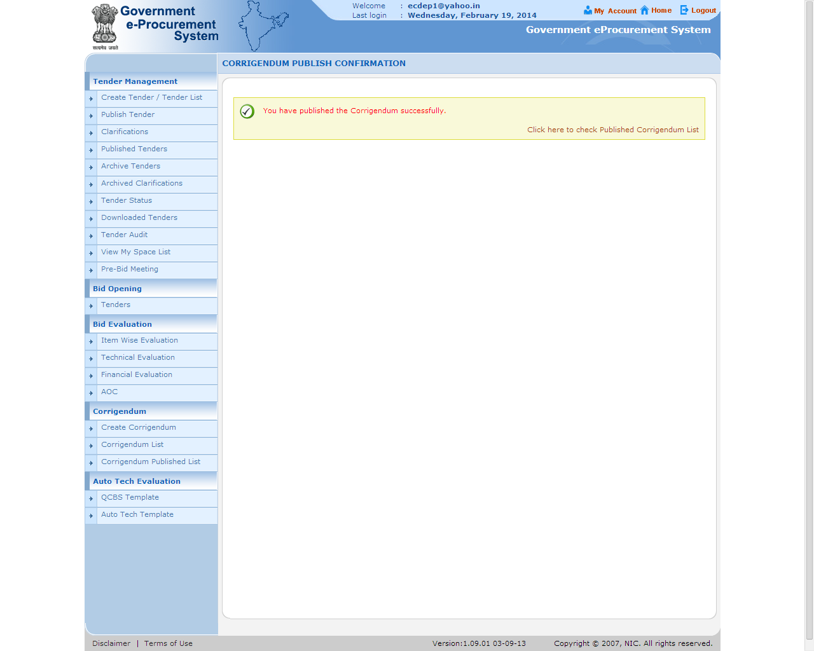
Confirmation message

Slide 23
e-Procurement
Corrigendum for BOQ.
To be issued before Bid Submission Start Date/Time

Slide 28
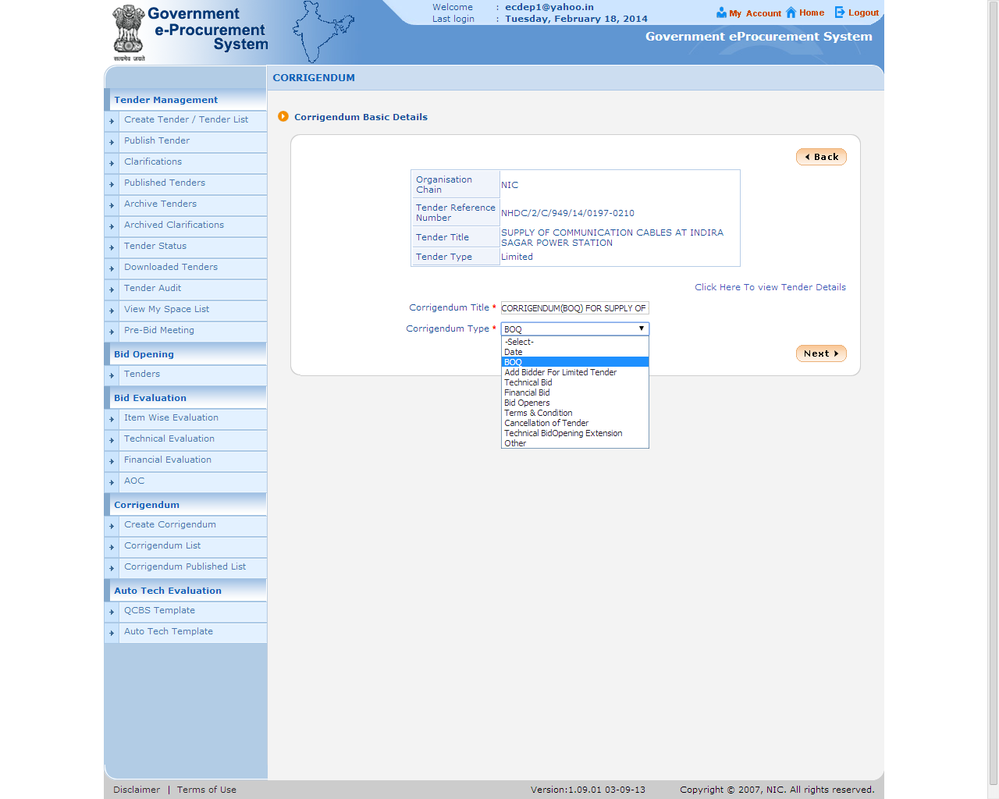

Slide 29
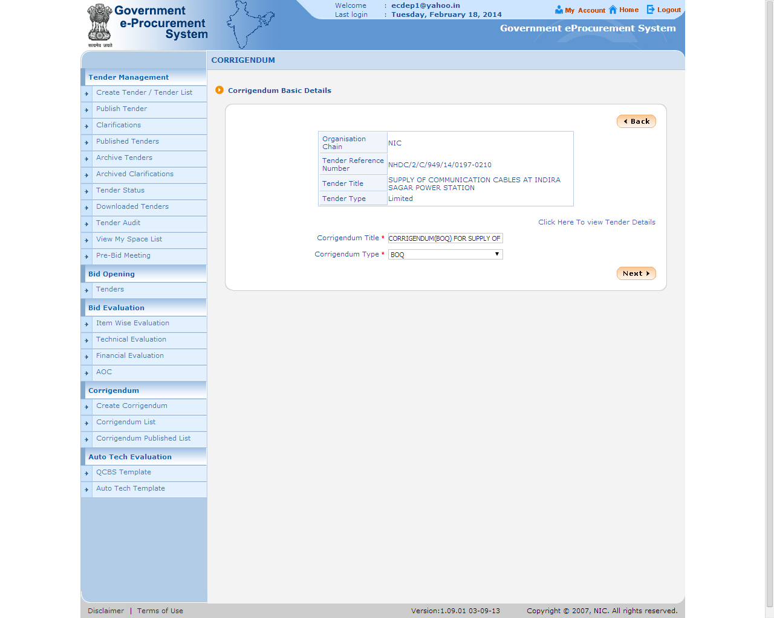

Slide 31
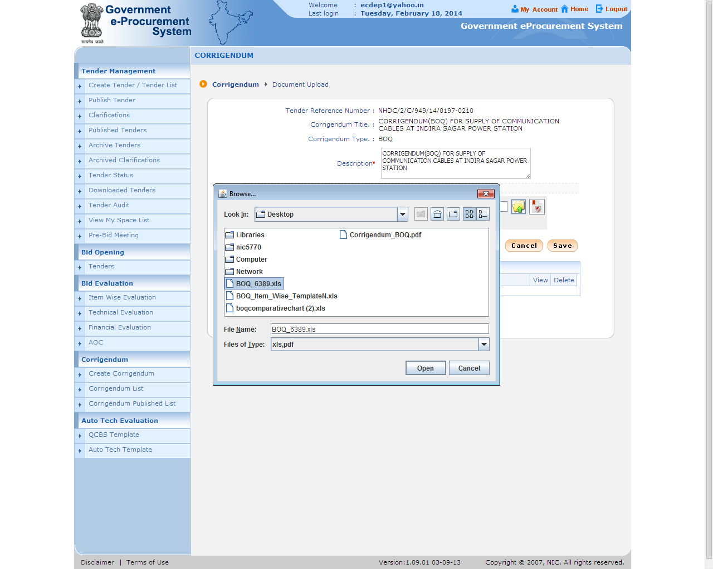

Slide 34
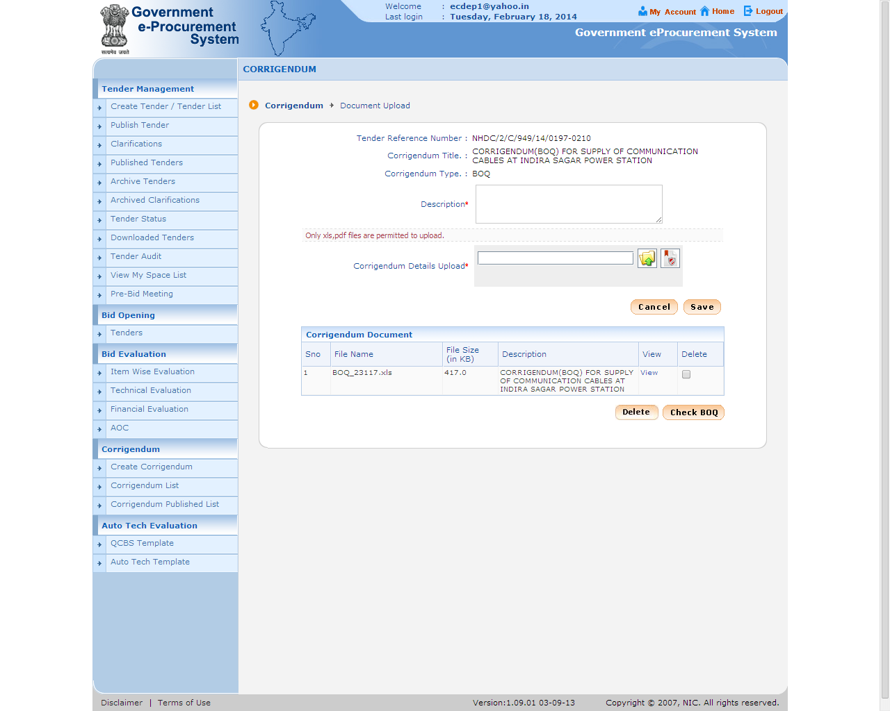

Slide 35
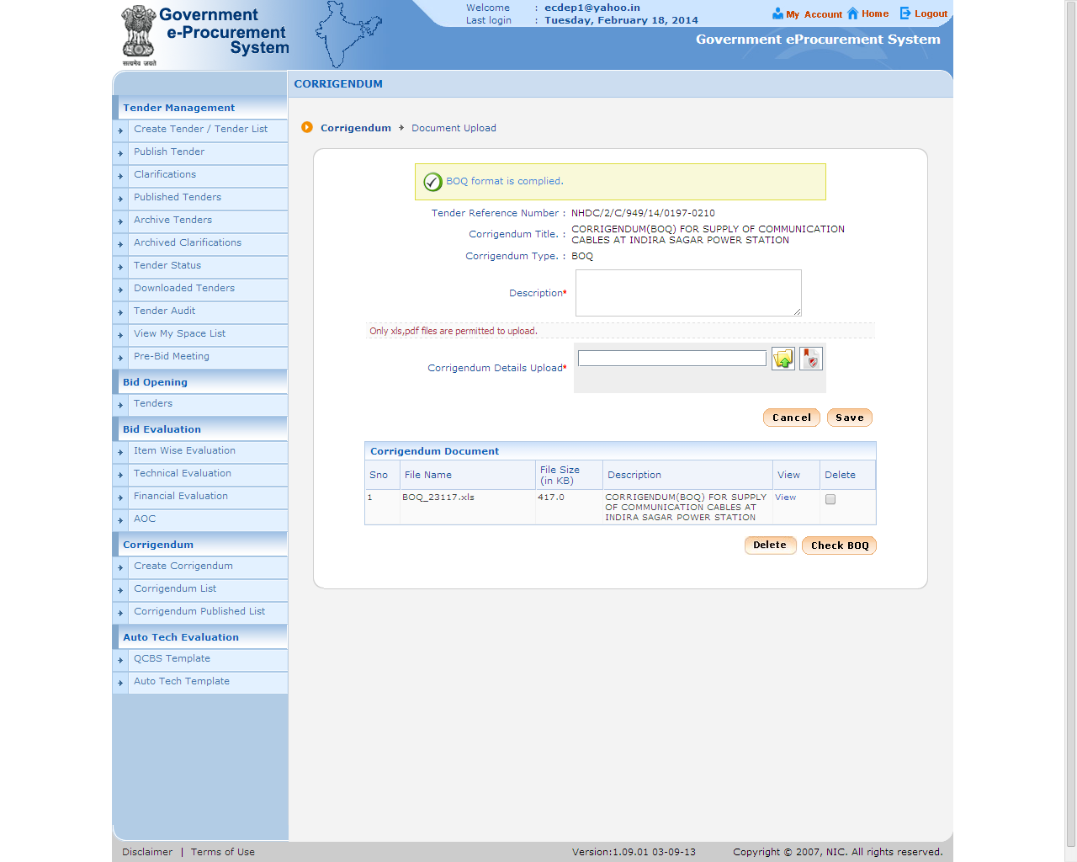

Slide 36
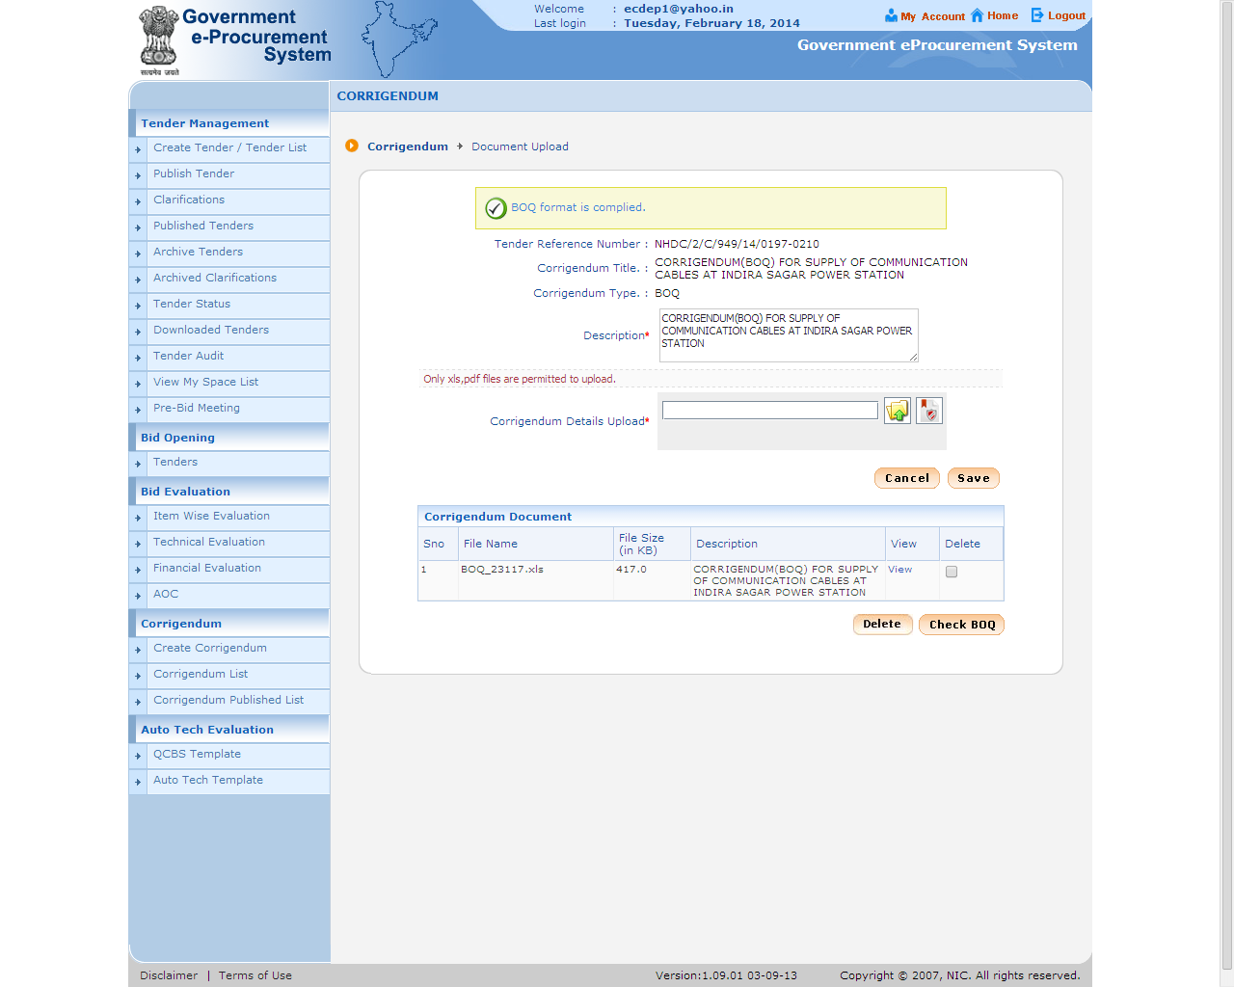

Slide 37
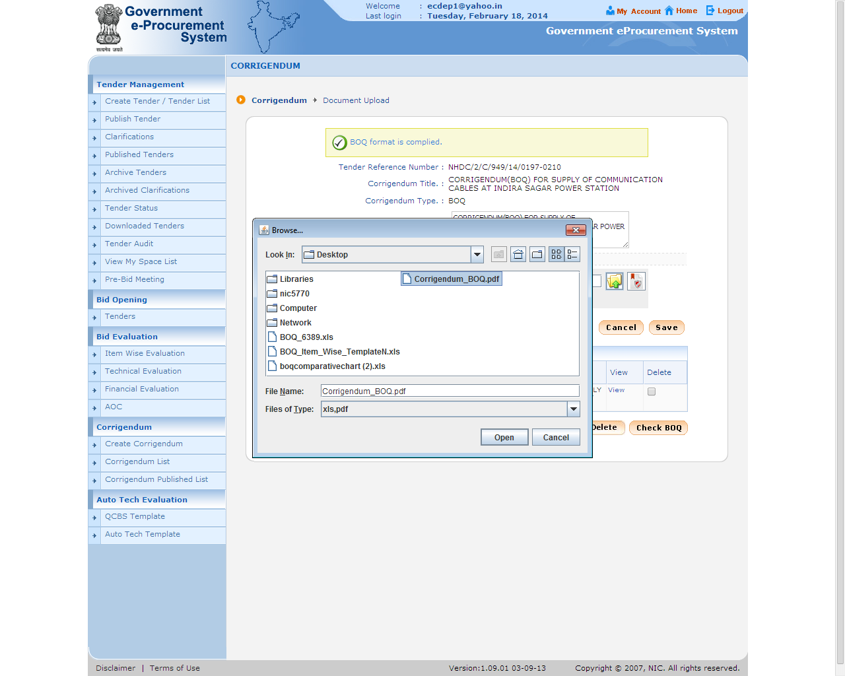

Slide 38
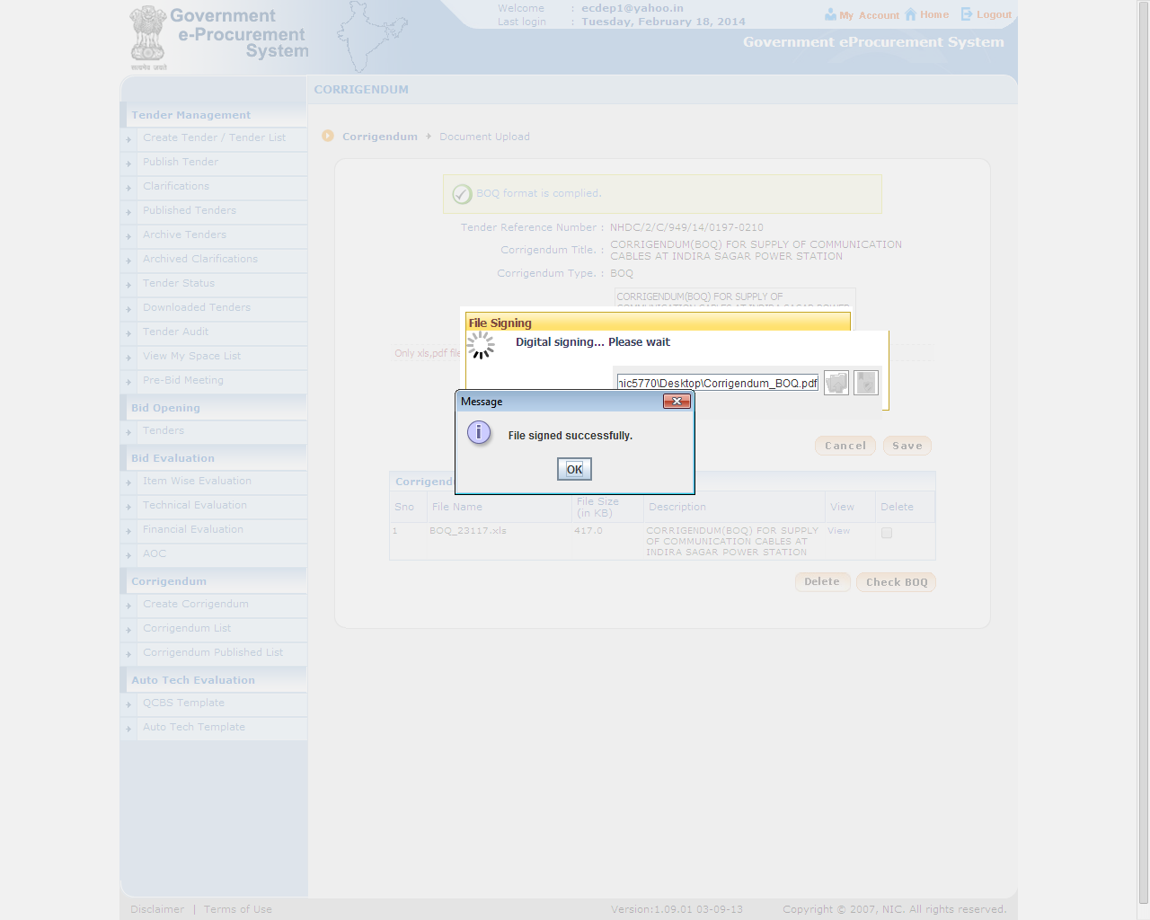

Slide 39
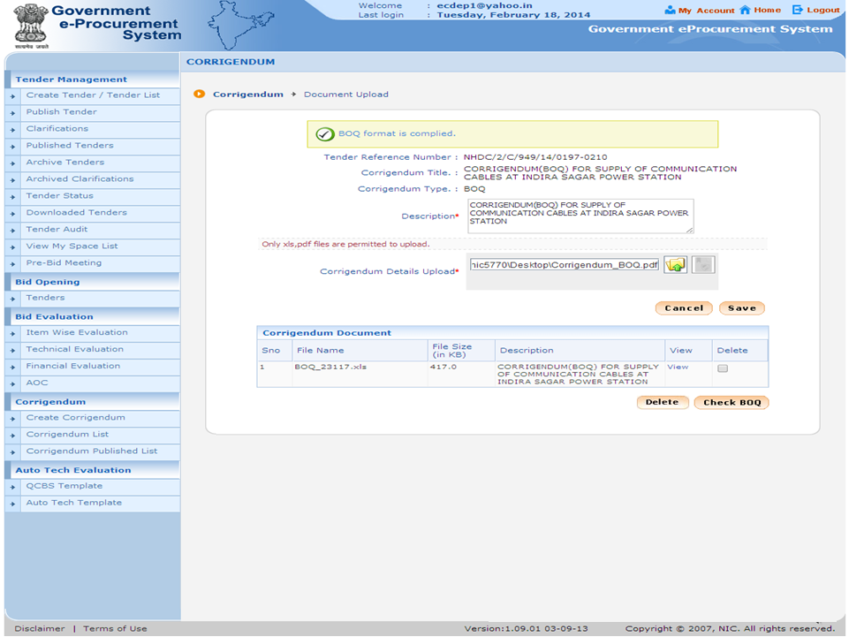

Slide 40
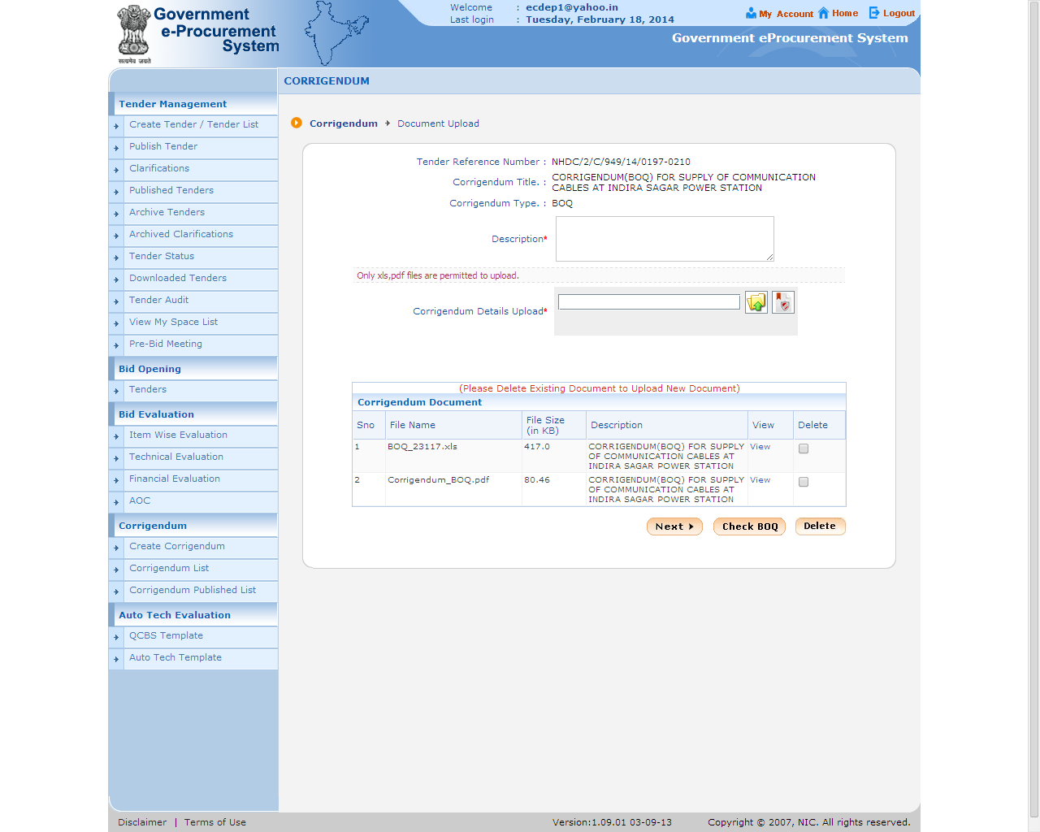

Slide 41
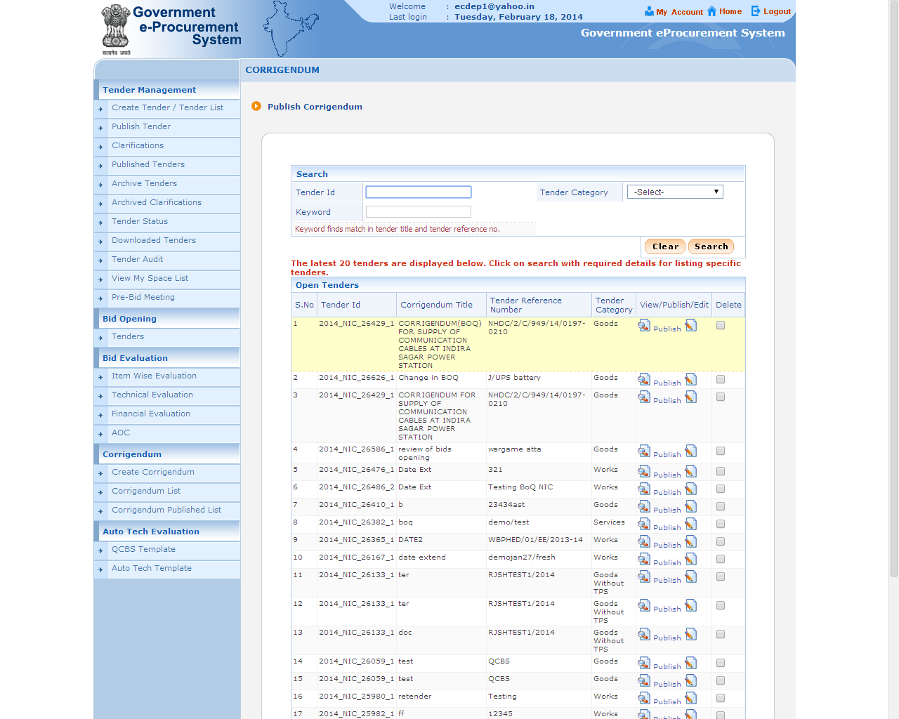

Slide 42
e-Procurement
Corrigendum for Technical Bid

Slide 43
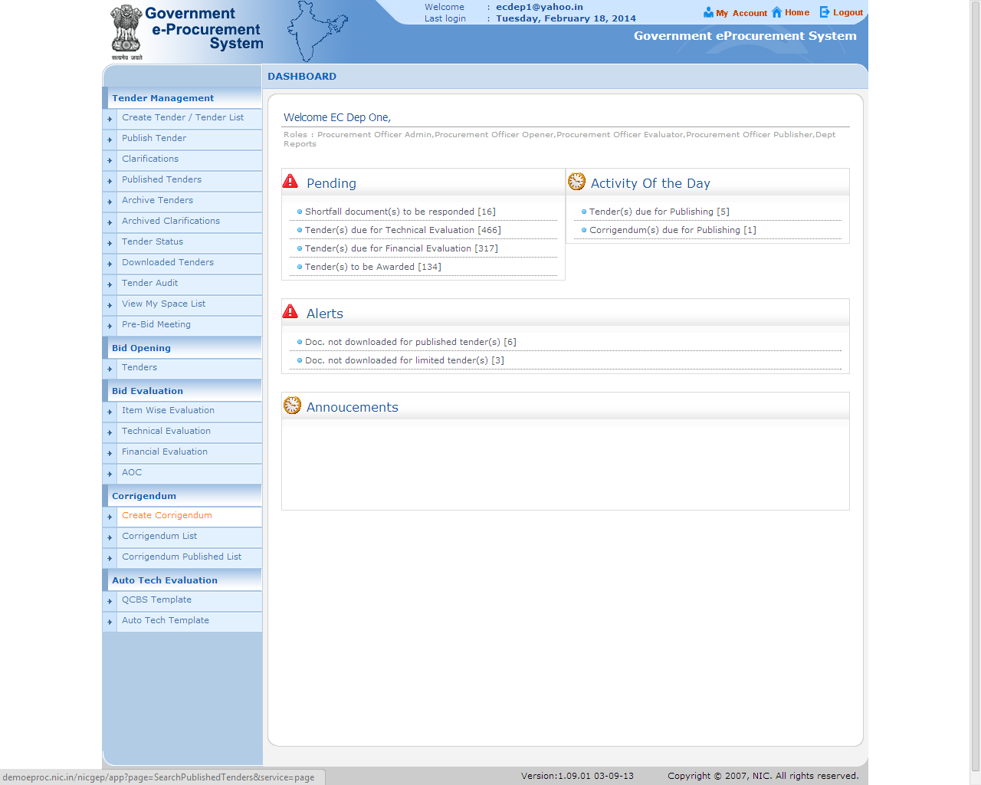

Slide 47
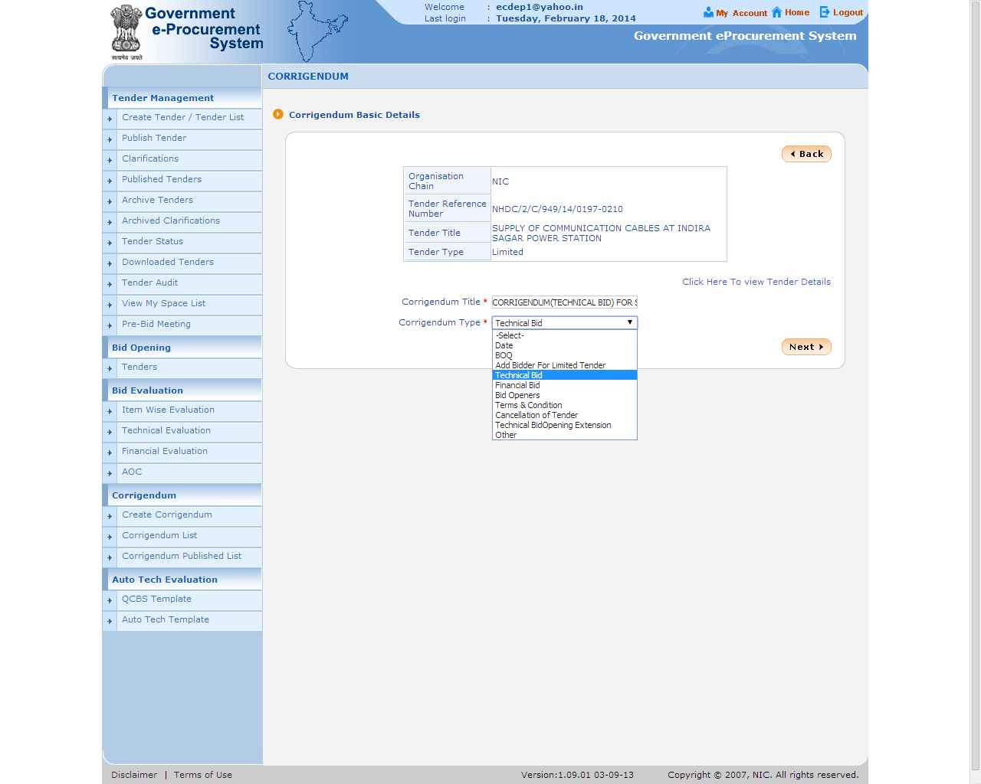

Slide 48
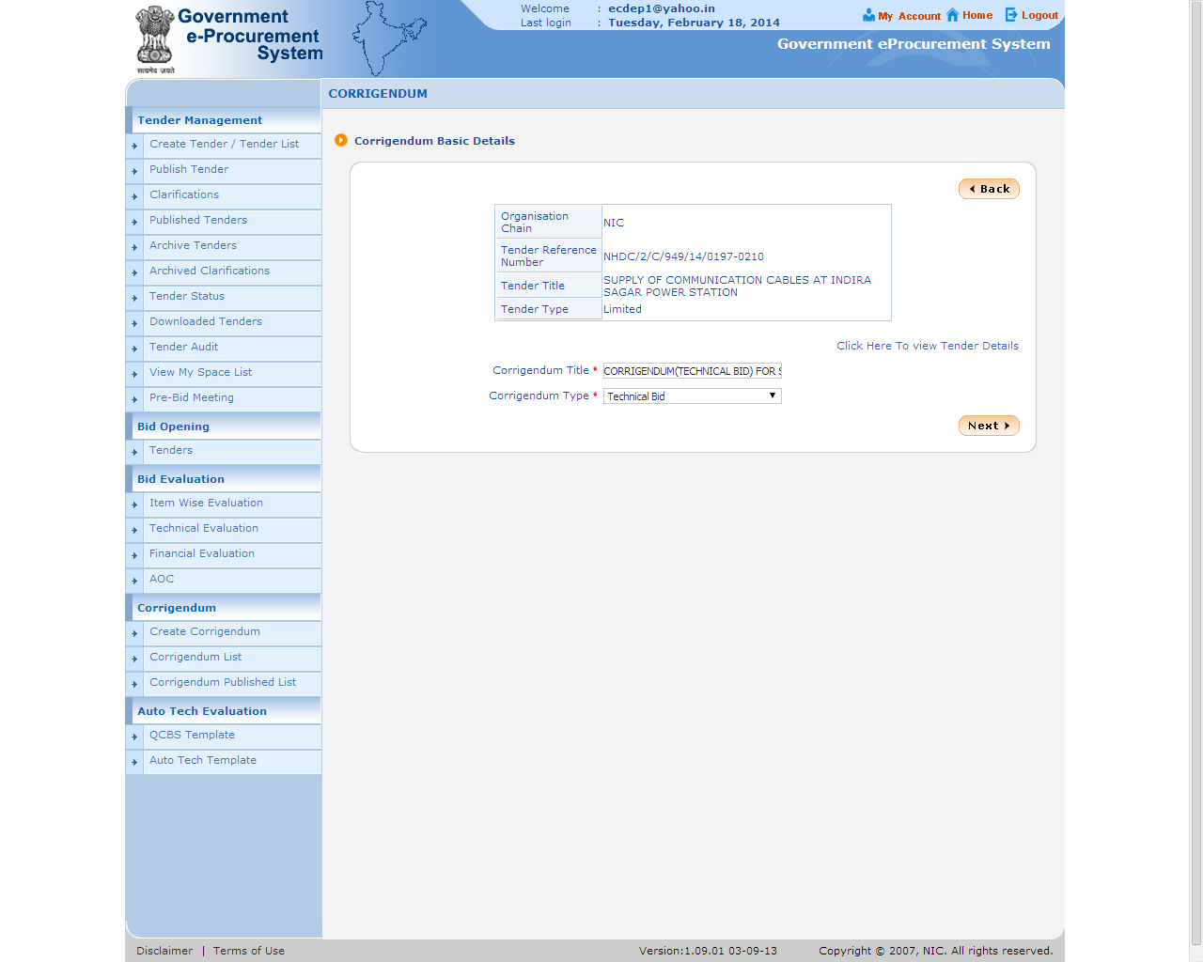

Slide 49
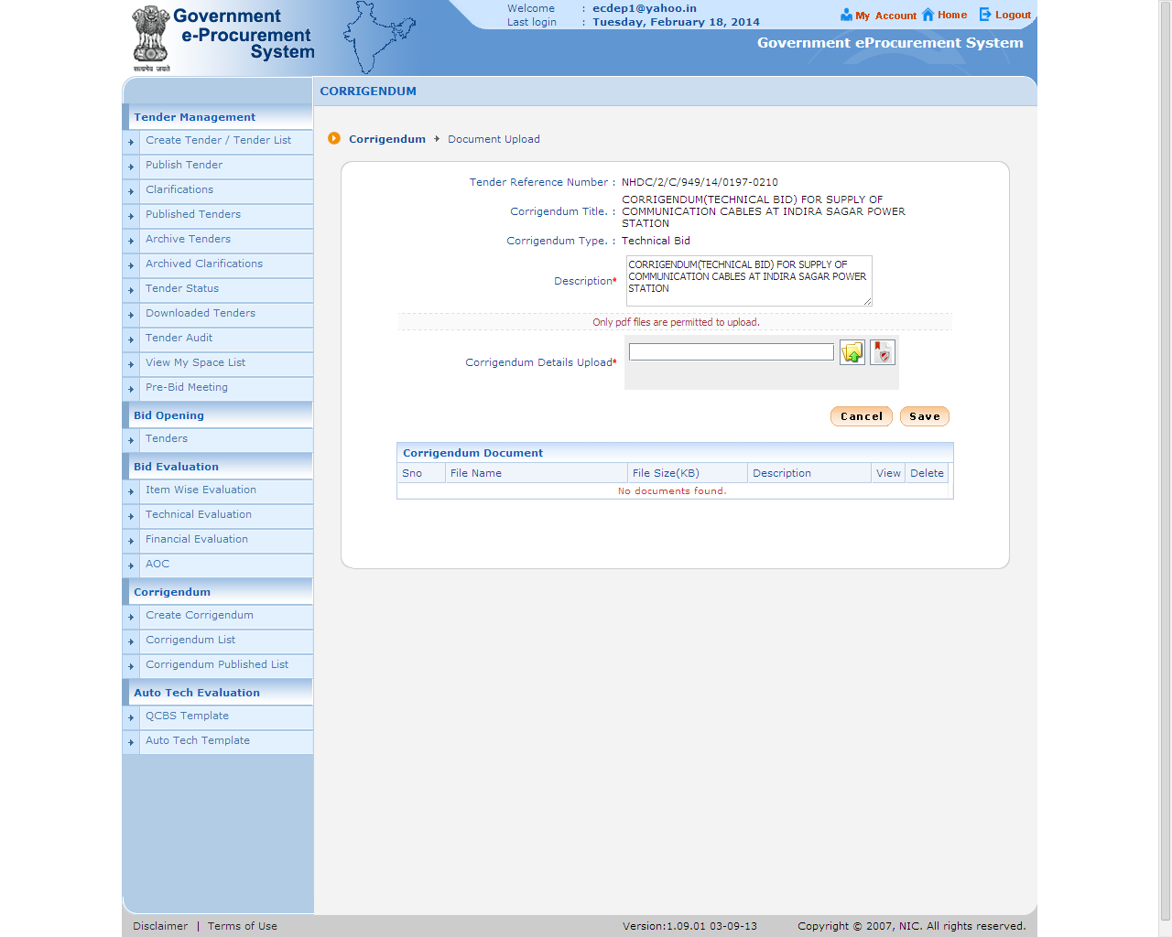

Slide 50
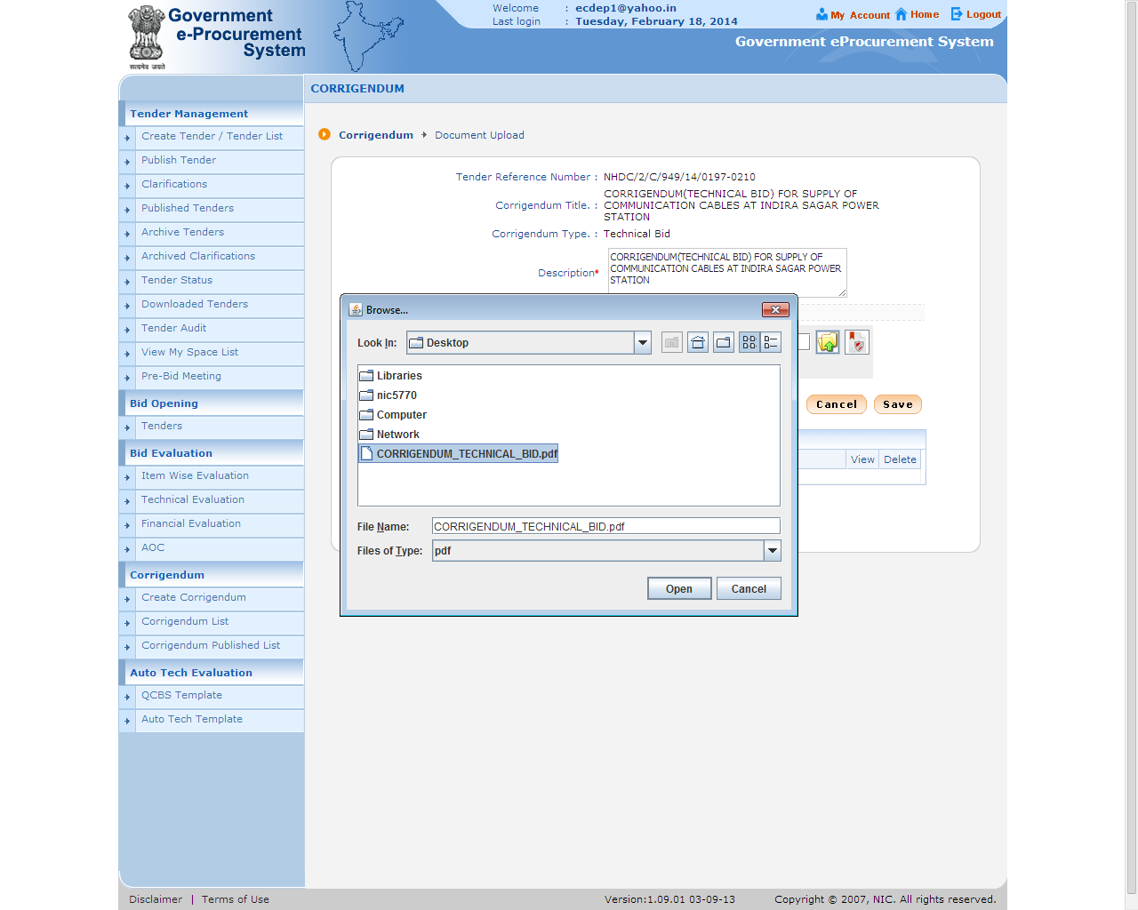

Slide 52
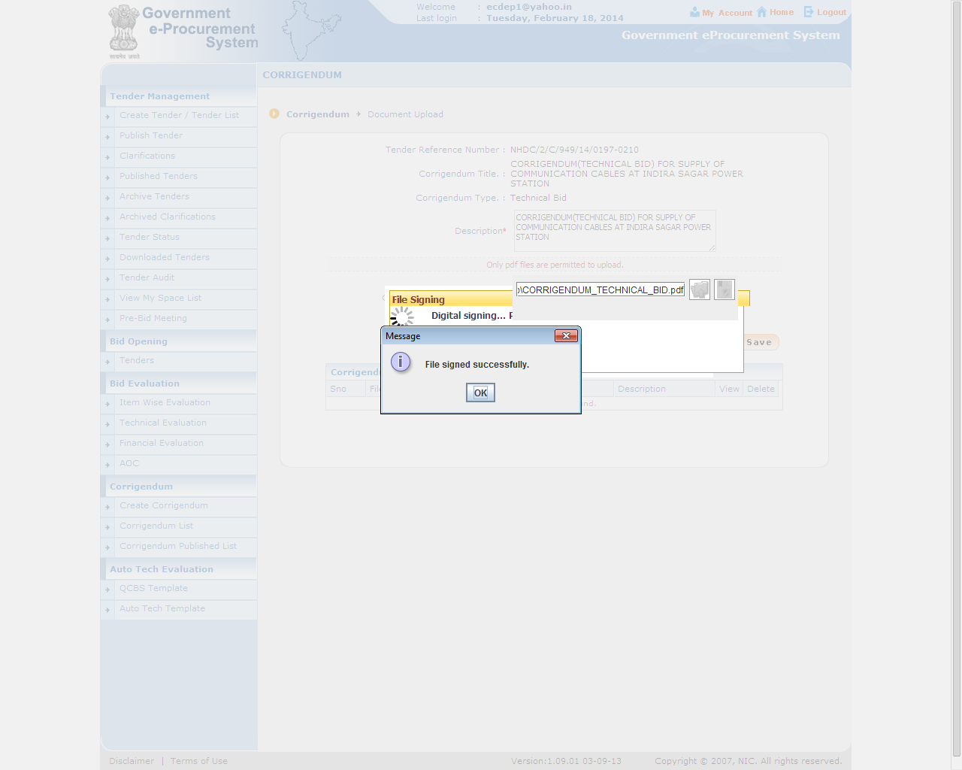

Slide 54
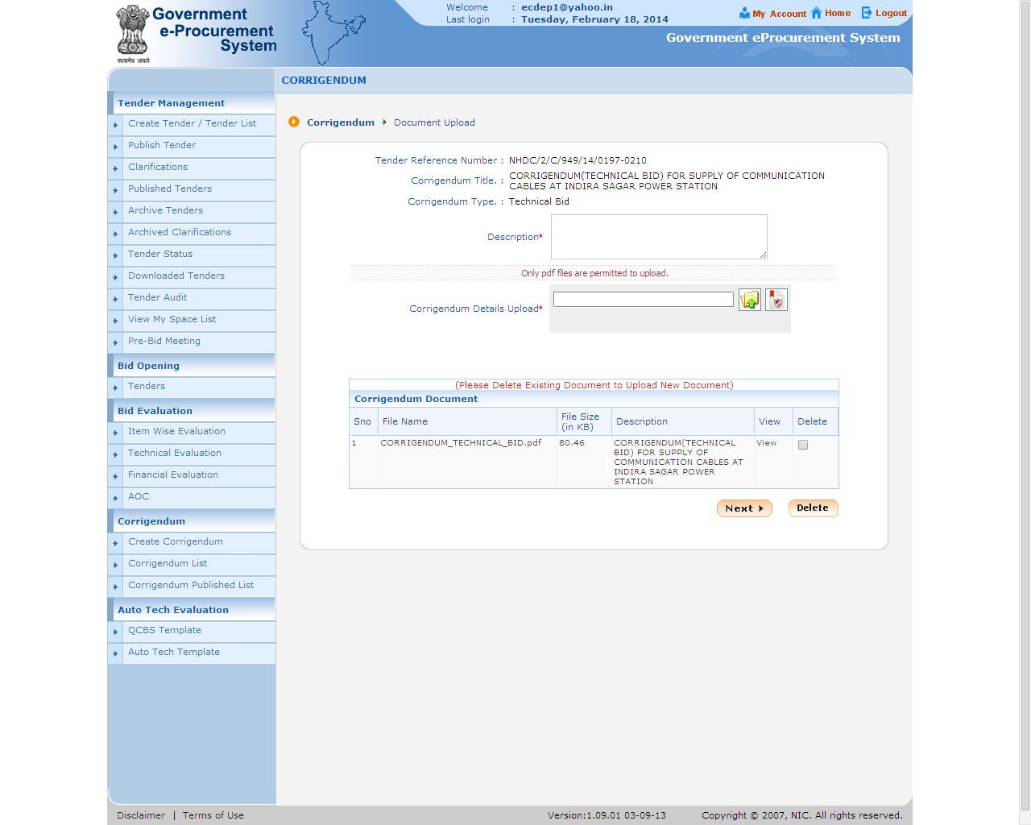

Slide 55
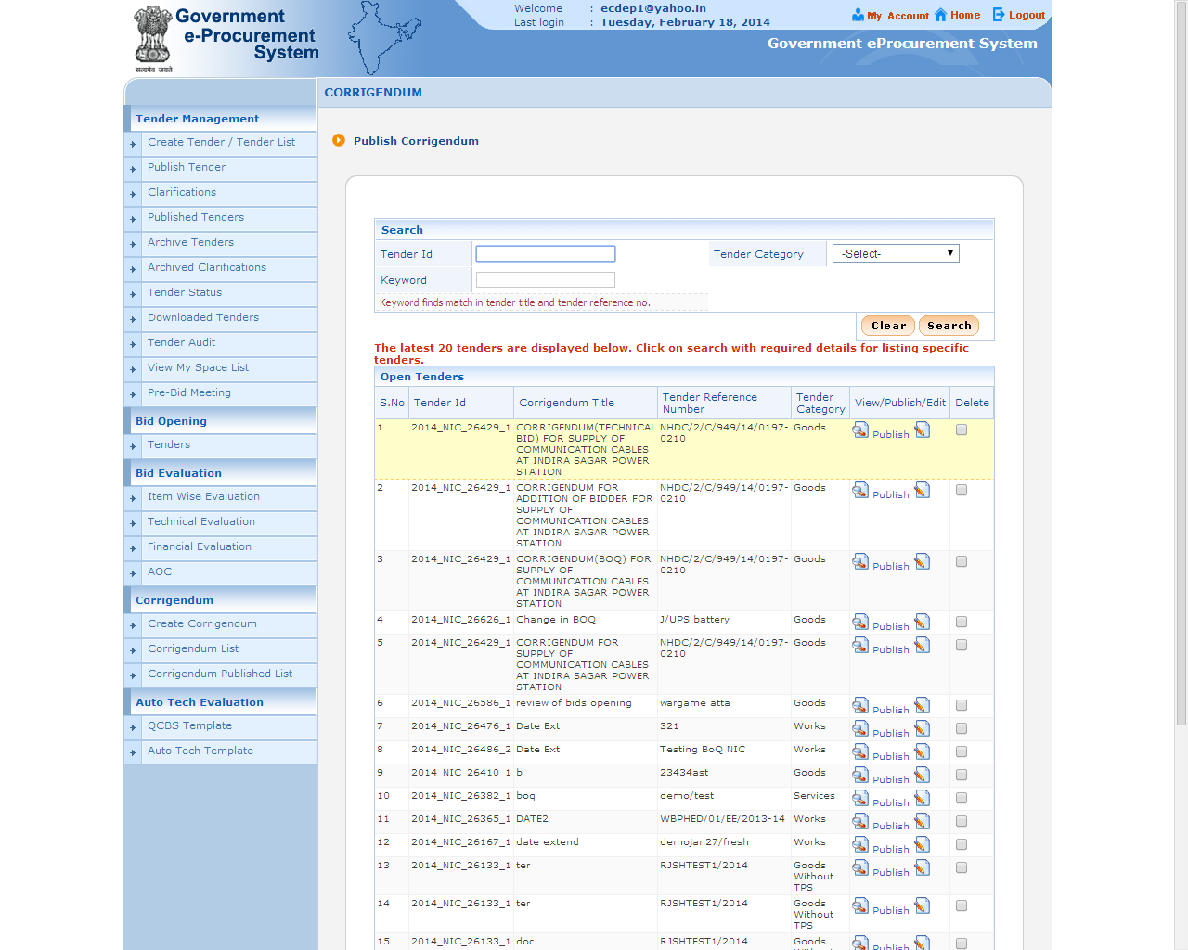

Slide 56
e-Procurement
Corrigendum for Financial Bid

Slide 60
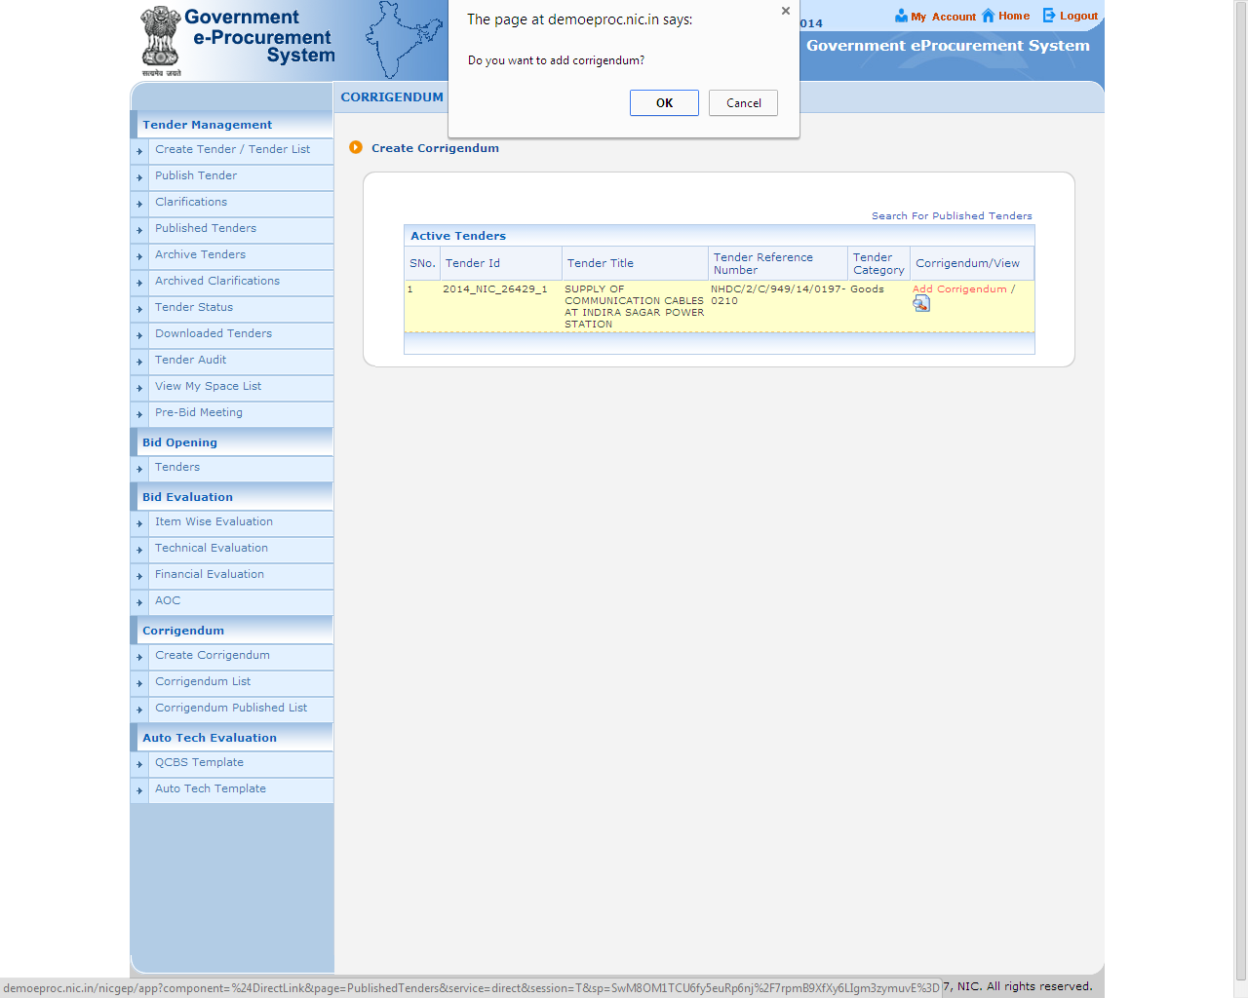

Slide 61
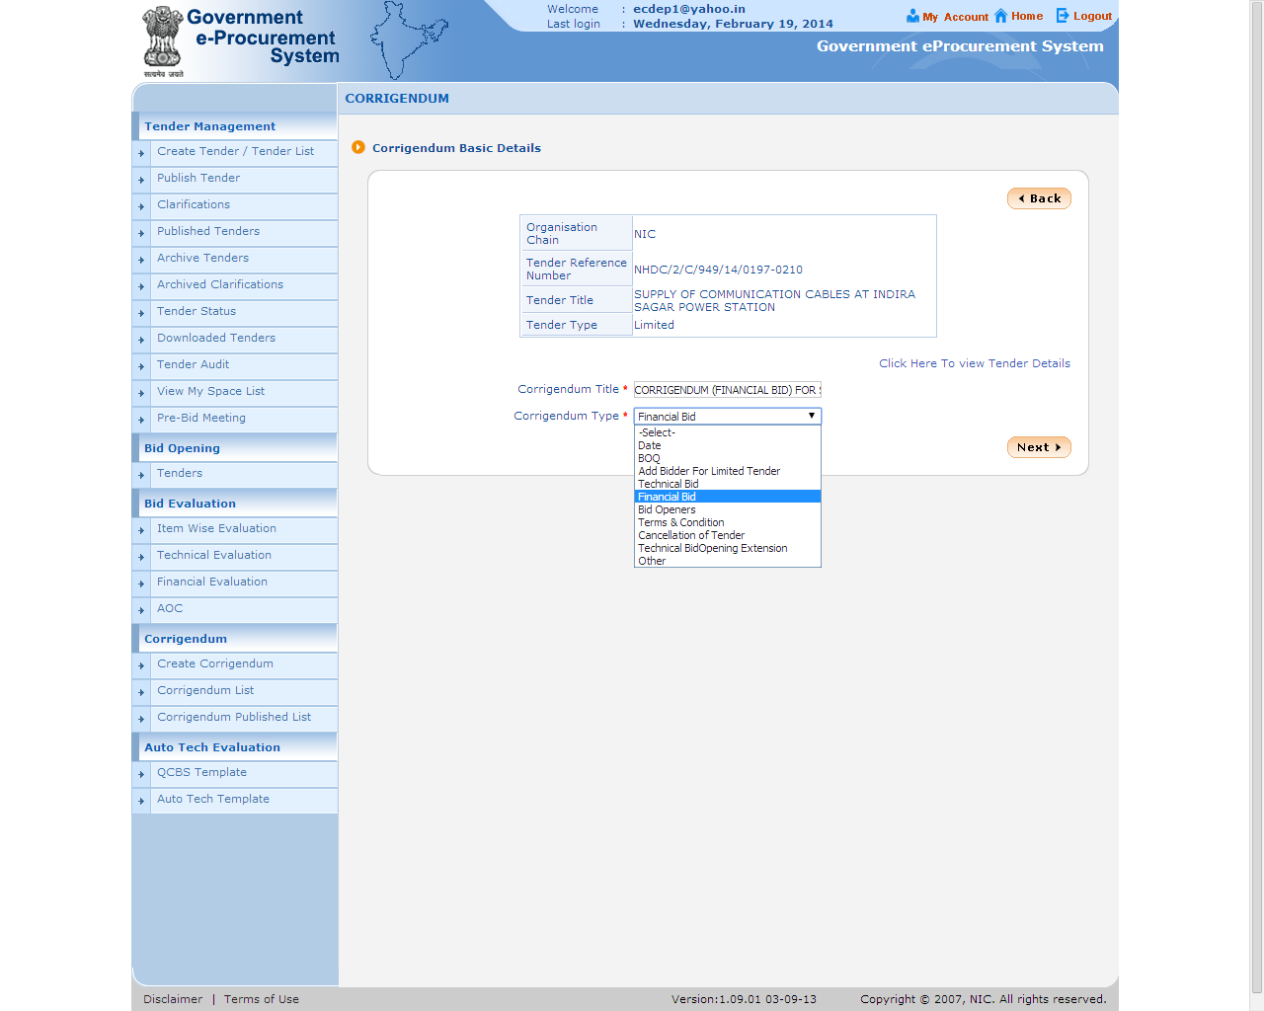

Slide 66
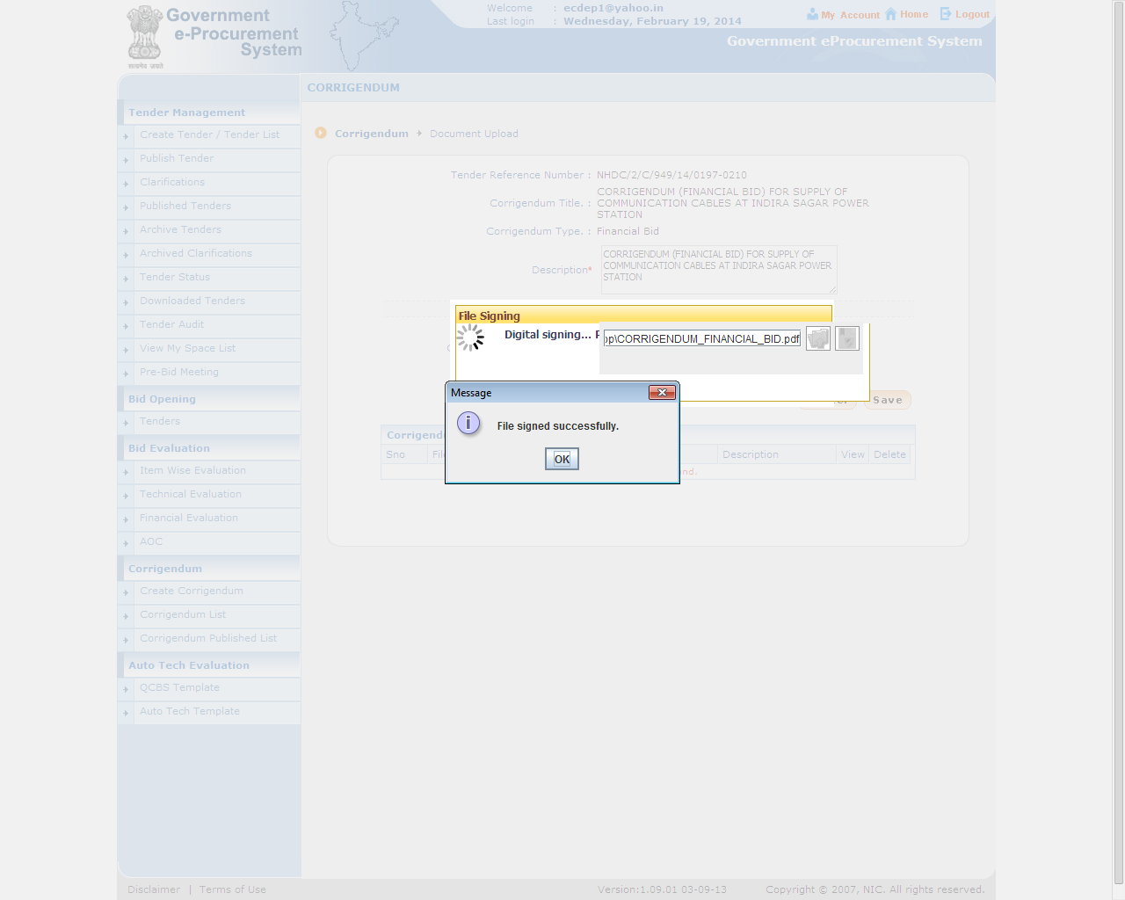

Slide 69
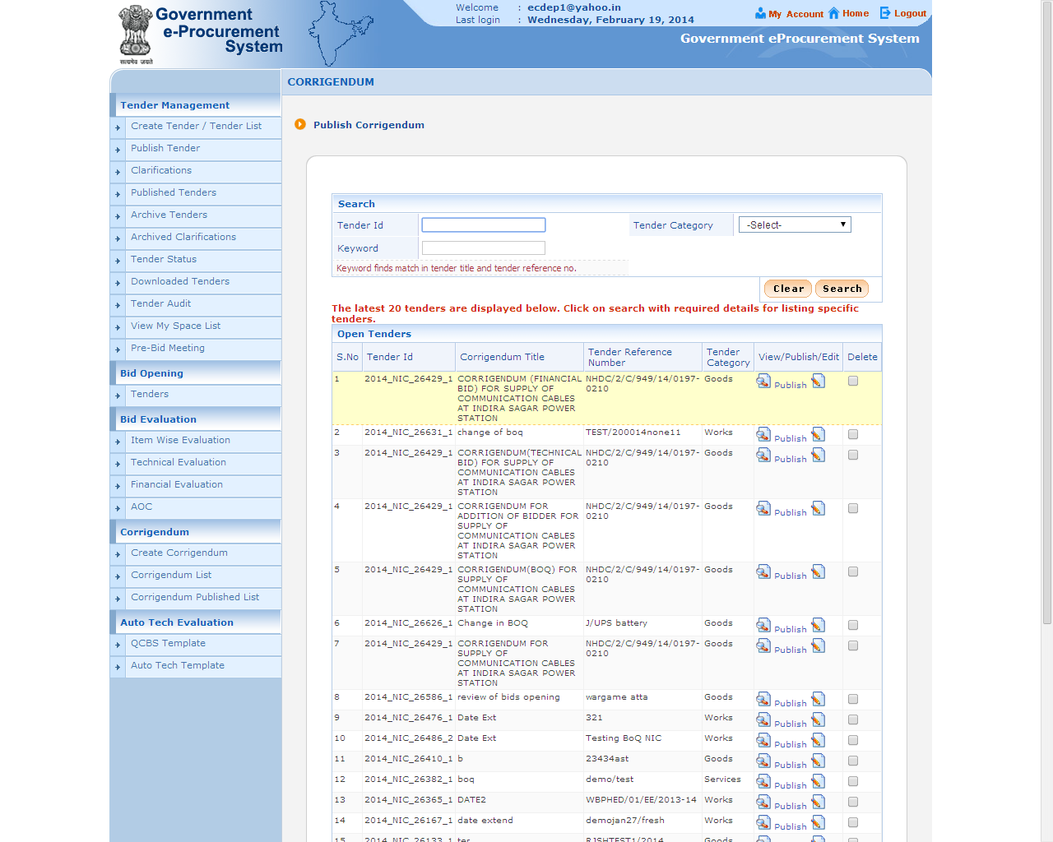

Slide 70
e-Procurement
Corrigendum for Bid Openers.
To be issued before Bid Submission Start Date/Time

Slide 77
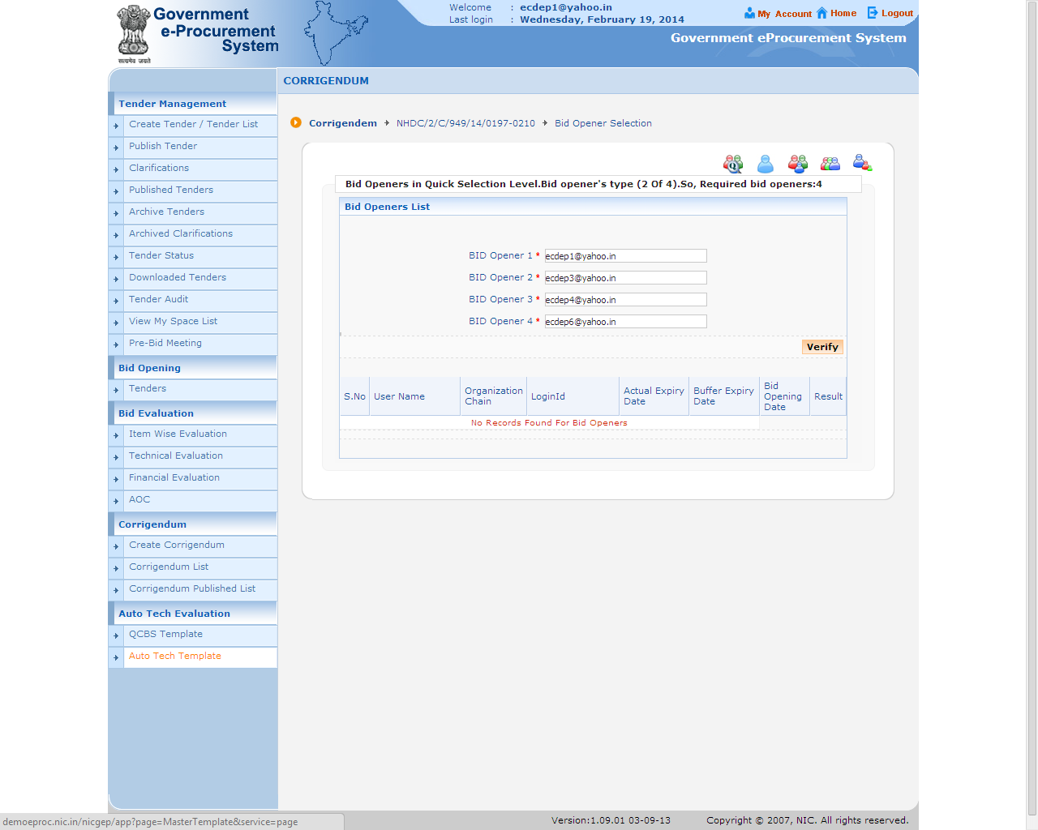

Slide 78
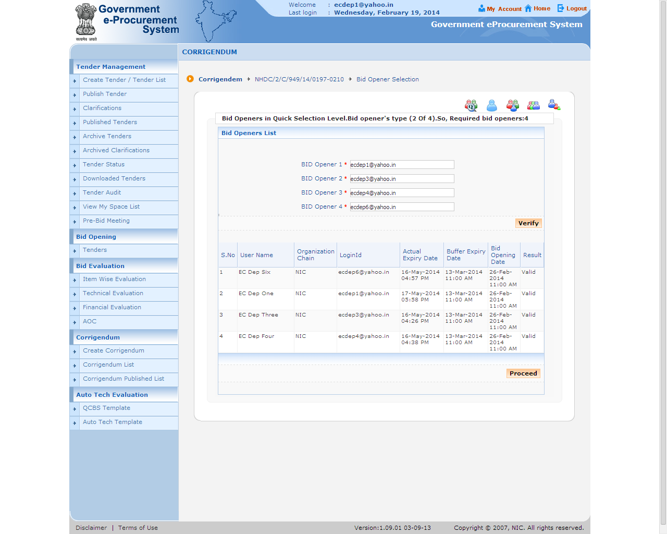

Slide 79
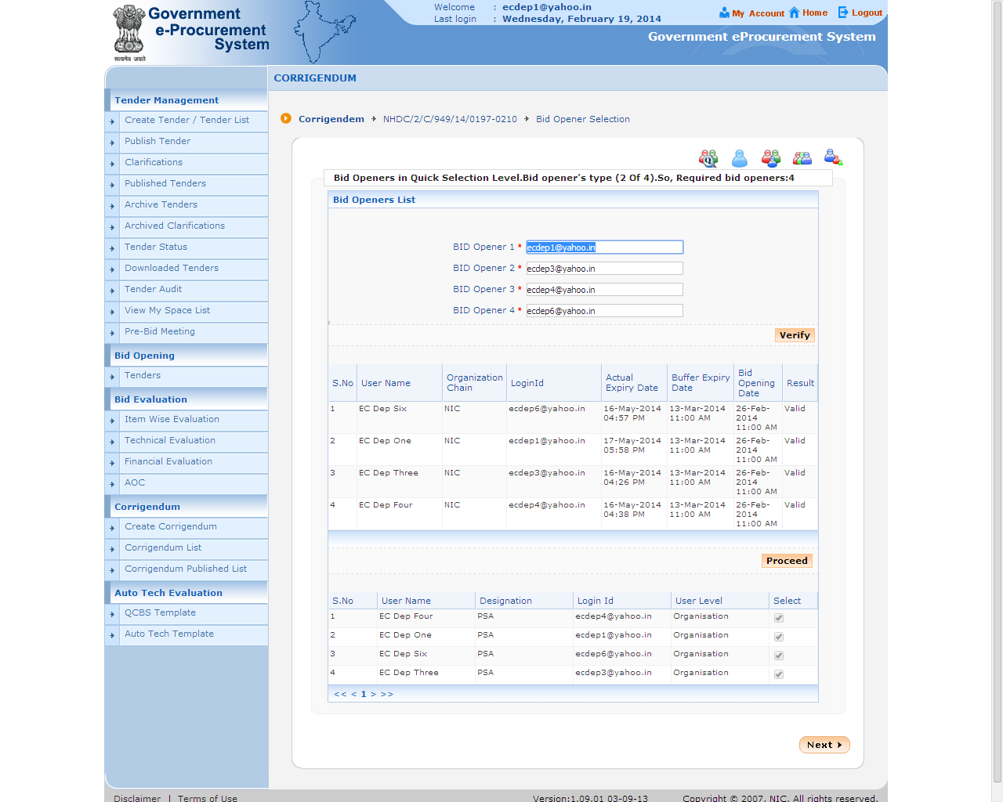

Slide 80
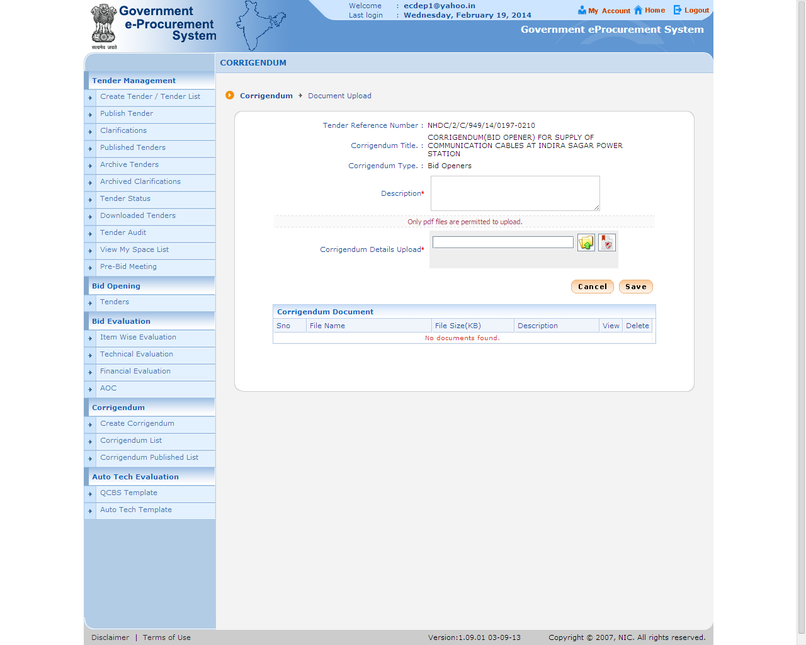

Slide 82
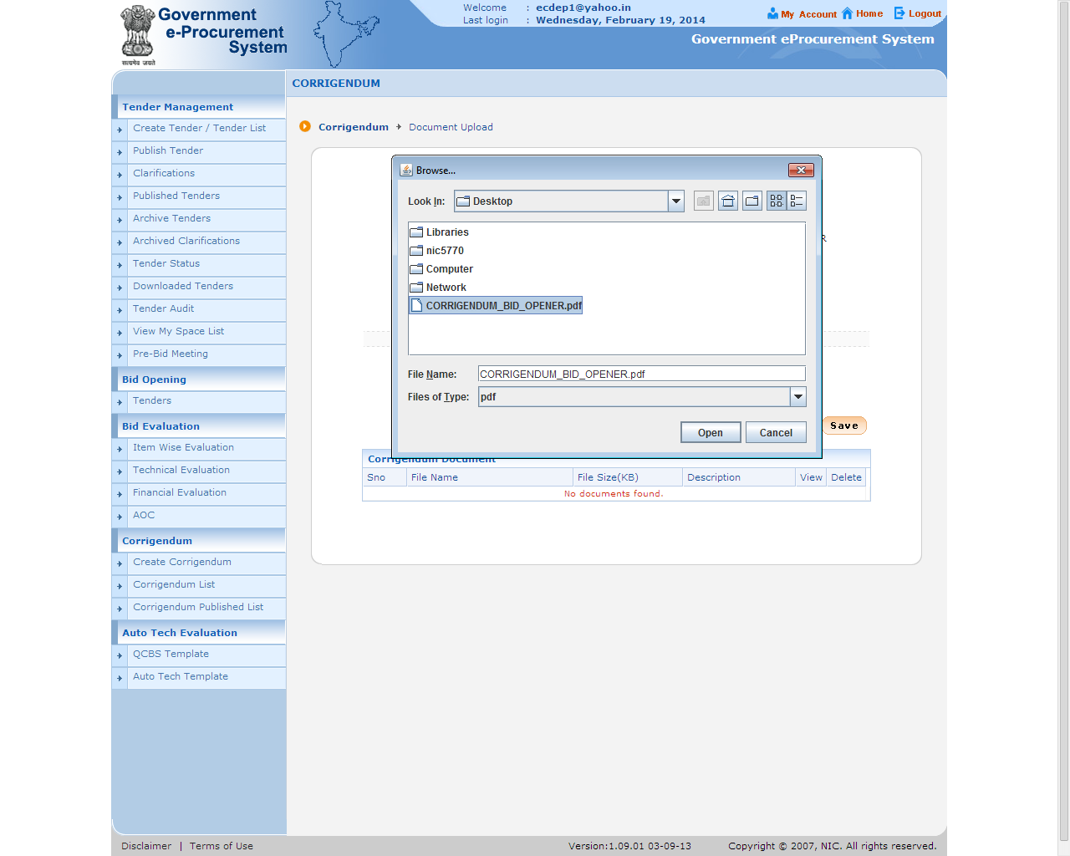

Slide 84
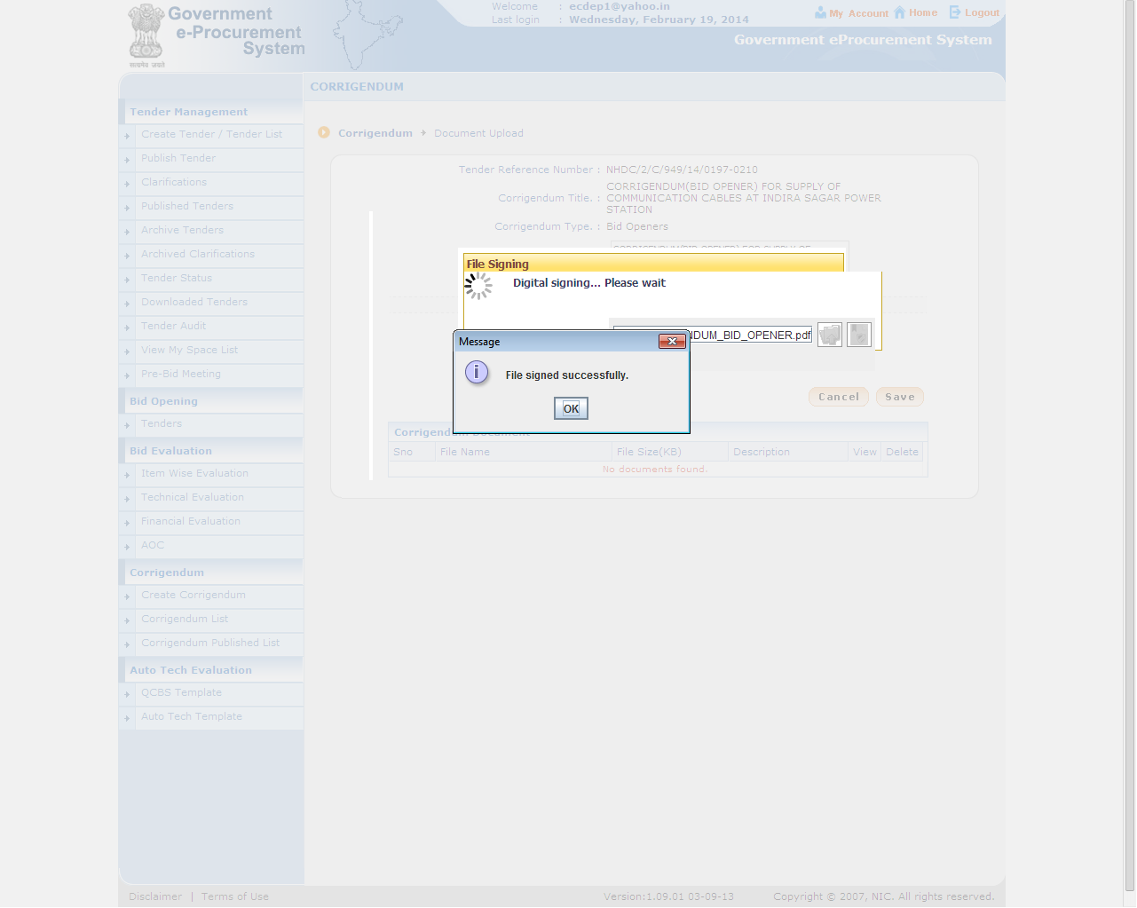

Slide 88
e-Procurement
Corrigendum for Terms & Condition

Slide 95
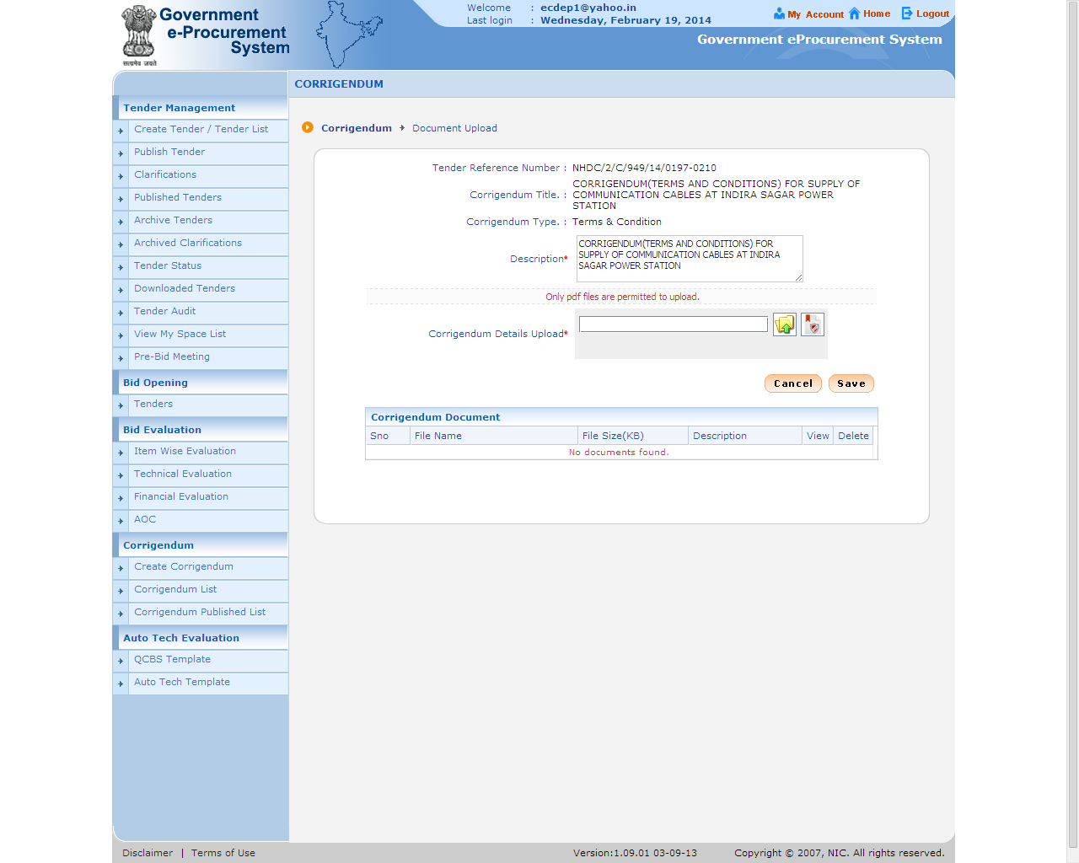

Slide 96
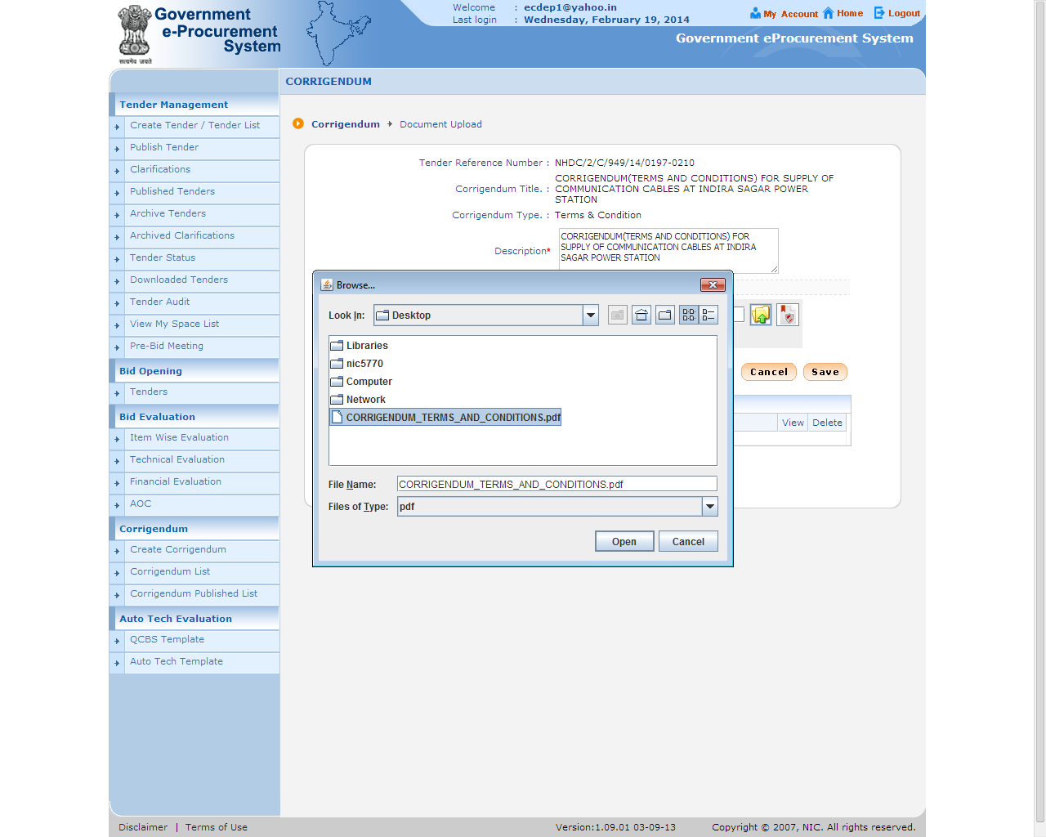

Slide 97
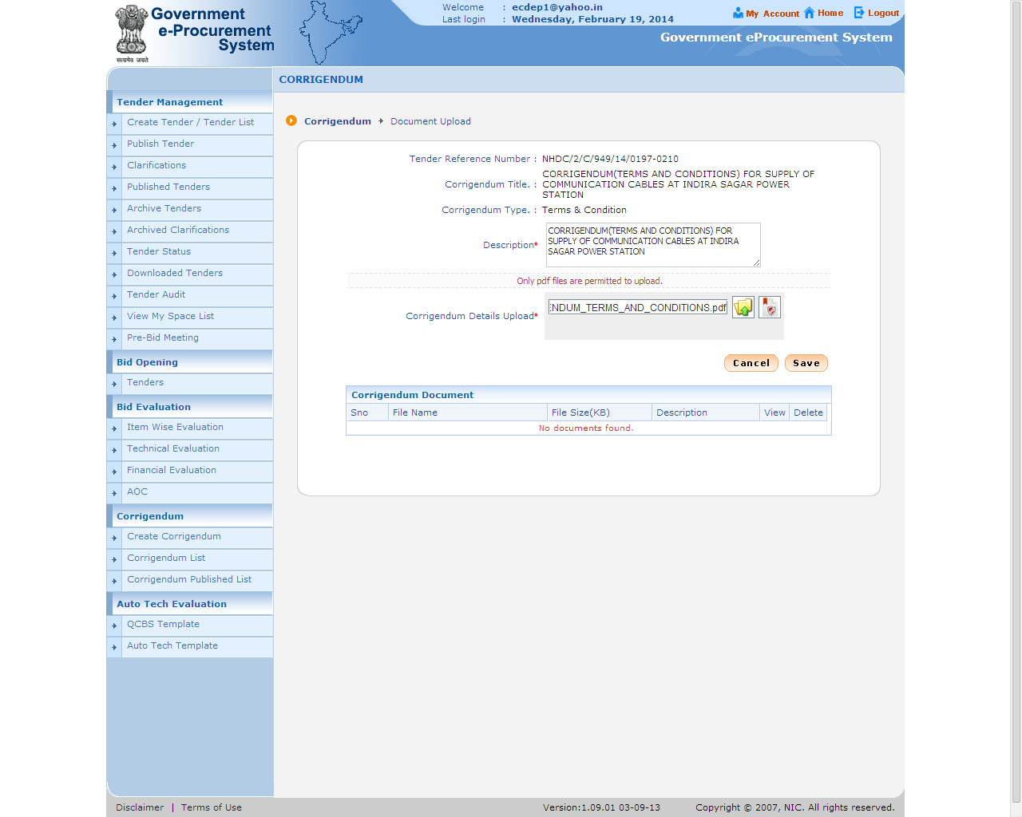

Slide 102
e-Procurement
Corrigendum for Other

